Slide 1

24-25 Determination Status Timelines
August 2024
Notes:
Hello, and welcome to this webinar on the determination status timelines for the 2024-25 school year. I just want to begin by letting everyone know that this session will be recorded and that all the information we share here will also be shared in document form following the session.

Slide 2


SPED Strategies
We work to *transform how students with disabilities experience school everyday* by ensuring leaders and educators across the nation have the tools and resources they need to effectively meet needs and prepare all learners to be successful in life after high school.
Notes:
My name is Theresa Nicholls from SPED Strategies. As many of you may know from the webinar, focus groups, and office hours back in May, SPED Strategies is partnering with DESE to provide more support and technical assistance to districts this year based on their determination status.
We shared a little bit about those supports during our conversations in the spring and we want to take this time today to walk through it all in more detail.

Slide 3
Agenda & Objectives
Welcome & Opening
Determination Statuses
Timeline for NI Districts
Timeline for NA Districts
Next Steps
Understand the supports available to your district
Understand the requirements expected of your district
Notes:
You’ll see the main objectives for our time today on the right side of your screen. We have two main goals for today.
First, to ensure that you understand all the support and technical assistance you have available to you this year, based on your determination status. And second, that you know what requirements and deliverables are expected of your district and on what timeline.
With those goals in mind, our agenda is pretty straightforward. We’ll take a quick minute to ground ourselves in the determination rubric, and then we’ll spend the bulk of our time walking through a high-level timeline of the supports, requirements and deliverables for the 24-25 school year.
We’ll cover the timeline for districts with a Needs Intervention status first, and then move to those with a status of Needs Assistance. And finally, we’ll close with a few practical next steps.

Slide 4
LEA Determination Statuses
Notes:
Okay, then let’s go ahead and get into the next portion of our session today.
As we said in the introduction DESE and SPED Strategies will be working together over the next few years to provide technical assistance and support to districts based on their determination status. This means that our team will be providing a variety of resources like trainings, root cause analyses, improvement plan consultation, etc. to districts across the state.
Before we dig in, let’s briefly review the process for making LEA determinations

Slide 5
Determination Status Rubric.
Determination Status Rubric
Notes:
As you all know, as part its system of general supervision, DESE must make annual determinations about each LEA’s specific needs for technical assistance or intervention in special education. DESE categorizes all districts into one of four statuses:
Meets Requirements (MR)
Needs Assistance (NA)
Needs Intervention (NI)
Needs Substantial Intervention (NSI)
These determinations are made using a rubric with eight different criteria; four performance criteria, and four compliance criteria. We won’t get into the details of the rubric now as we’ve covered that in previous webinars. However if you want to dig deeper into understanding the rubric we’ll send out a few different resources following this webinar, including a link to the recording of that previous webinar, a quick reference guide that provides a strong overview of each criteria in the rubric, and an FAQ doc with answers to more detailed questions.
But all that to say, if your district received a determination status of Needs Assistance or Needs Intervention you can use the criteria on this rubric to see where to begin your root cause analysis and improvement planning work.

Slide 6
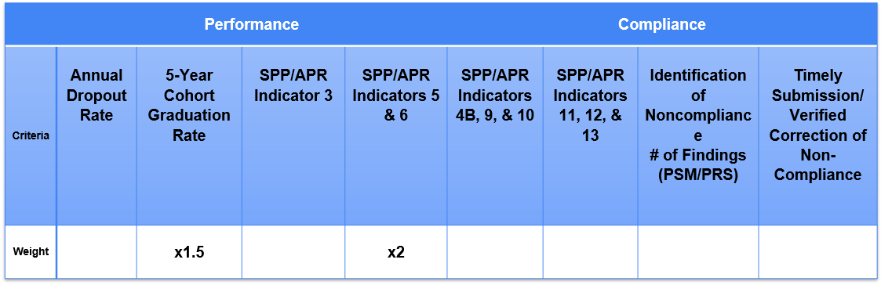
Determination Status Rubric
Notes:
As you all know, as part its system of general supervision, DESE must make annual determinations about each LEA’s specific needs for technical assistance or intervention in special education. DESE categorizes all districts into one of four statuses:
Meets Requirements (MR)
Needs Assistance (NA)
Needs Intervention (NI)
Needs Substantial Intervention (NSI)
These determinations are made using a rubric with eight different criteria; four performance criteria, and four compliance criteria. We won’t get into the details of the rubric now as we’ve covered that in previous webinars. However if you want to dig deeper into understanding the rubric we’ll send out a few different resources following this webinar, including a link to the recording of that previous webinar, a quick reference guide that provides a strong overview of each criteria in the rubric, and an FAQ doc with answers to more detailed questions.
But all that to say, if your district received a determination status of Needs Assistance or Needs Intervention you can use the criteria on this rubric to see where to begin your root cause analysis and improvement planning work.

Slide 7
Technical Assistance Timeline for NI Districts
Notes:
Which brings us into our next section. We know that it is no small task to uncover the root causes that are creating these gaps, build an improvement plan to address them, and then implement that plan effectively. DESE has put together a combination of technical assistance and deliverables to help support districts through that process. Like any good system of support, this one is tiered, to provide the right level of support to each district. So, first, let’s walk through the timeline for districts with a status of Needs Intervention.

Slide 8
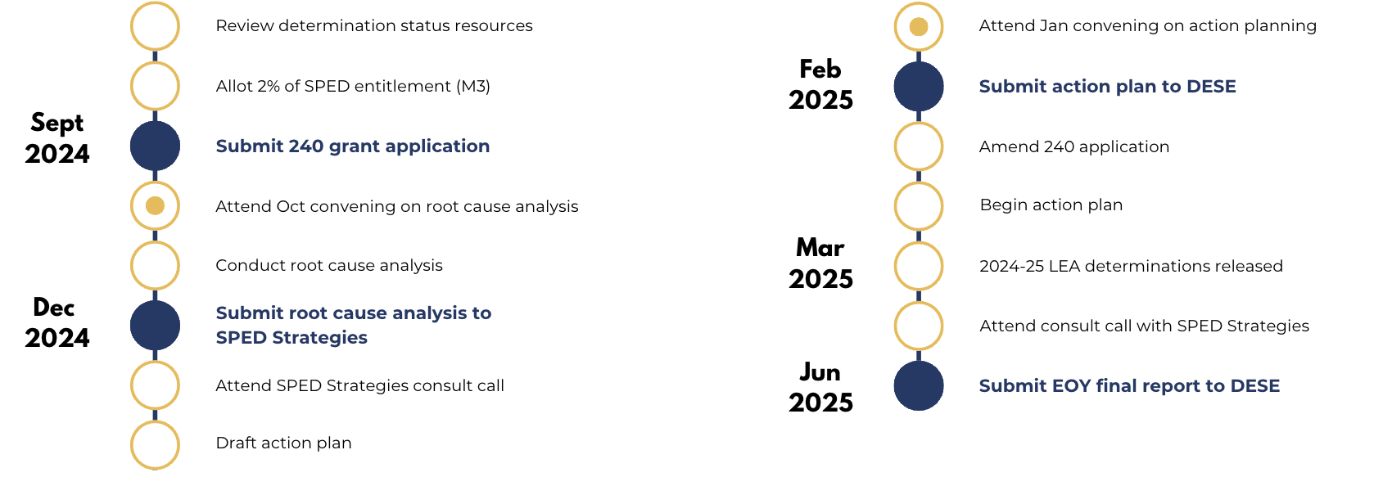
Timeline for NI Districts
Notes:
You’ll receive this timeline in document form following the webinar, but we want to take a moment to talk through it together here. In this timeline visual, the gold circles represent activities and the gold circles with a dot inside are onsite convenings. The blue circles represent district deliverables. All of the activities and deliverables in this timeline are required for each NI district.
The first step for NI districts is to make sure you’ve accessed the resources we named earlier–the webinar recording, quick reference guide, and FAQ–to make sure you fully understand your status, the criteria on which you’re focusing, and the data behind it. Again, those materials will all be shared after this webinar if you haven’t seen them already. You’ll also need to allot 2% of your SPED entitlement allocation to targeted systemic improvement aligned with the criteria on which you’re focusing. This is all part of the “Making Money Matter” or M-cubed program, which you can read more about in the FAQ.
A few districts have asked about the need to make that allotment in the fall before they’ve had more technical assistance and time to perform their root cause analysis and improvement planning, which makes sense. For this year, you’ll need to decide on those allotments by September 30th, based on the current understanding you have of your data and your gaps. Later in the year, as you’ll see in a minute, there’s space in the timeline to amend your 240 application if needed, based on what you’ve learned. Once districts have all gone through this year’s TA process, we’ll be able to align the supports so that they work more fluidly with your budget planning for the following year.
The first major support for NI districts will also come in October. You should have already received a “Save the Date” email for a two-day root cause analysis convening happening in one of three weeks in October. Our team at SPED Strategies will be facilitating these sessions. Your teams will get a chance to dig into the root causes for your district and will leave prepared to complete the process with a broader team following the session. We just finalized the locations for each convening and we’ll be able to offer the sessions in three different locations across the state, to make them more accessible to your teams. Look for an email with registration and location information for your convening and be sure to get your team signed up!
As you all know, root cause analysis isn’t something that’s done in a day, it’s a process that’s done over time, with a team, using various sources of data. Across the fall, each of your teams will complete your own root cause analysis and then you’ll have a chance to discuss it 1:1 with our team. You’ll send us your analysis, and we’ll take time to review it and set up a virtual consult call to talk through it, answer questions, and provide feedback and guidance as you move on to creating your action plan.
Following that virtual consult you’ll create a first draft of your improvement plan which you’ll bring to our second convening of the year in January. At that one-day convening we’ll do a deep dive on improvement planning and you’ll get to use that input to revise and finalize your own plan. Then, by February, each NI district will submit their plan to DESE so they have a clear picture of your focus areas, the steps your taking, your rationale for the plan, and how you’ll be measuring your progress.
As I mentioned before, at this point in the year, if you’ve made some significant shifts in your thinking based on the root cause analysis and improvement planning work you’ve done, you may amend your 240 application. And then you’ll begin implementing your action plan. Some of the steps will be changes you can make in spring of 2025 to address low hanging fruit and secure some early wins. Other steps will be laying the groundwork for longer term portions of your action plan that will begin later in the summer or fall.
In March, DESE will release the 24-25 determinations, and you’ll want to review your plan in light of those determinations, in case something new surfaces that you didn’t catch in your data review and root cause analysis earlier in year. Each NI district will attend one final consult call with our team to discuss your 24-25 status and your action plan, and make sure you feel confident in the approach you’ve mapped out for the 25-26 school year.
Lastly, in June, you’ll submit a final report to DESE sharing the work you’ve done this year, the impact you’ve seen to date, and the steps that are in place for the 25-26 school year.
One quick note on this timeline before I pause for questions and move into the Needs Assistance timeline. We will be providing more information about the structure and content of each of the deliverables during the convenings so you know what’s involved in submitting your root cause analysis to us for example, or your action plan and EOY final report to DESE.
Okay, with that said, I’ve just walked through a lot. You can always reach out with questions after this webinar once you’ve had more time to look at the timeline more closely, but are there any questions we can answer now, before we look at the process for Needs Assistance districts?

Slide 9
Technical Assistance Timeline for NA Districts
Notes:
Okay, then let me go ahead and move forward and we’ll talk through the timeline for districts with a status of Needs Assistance.

Slide 10
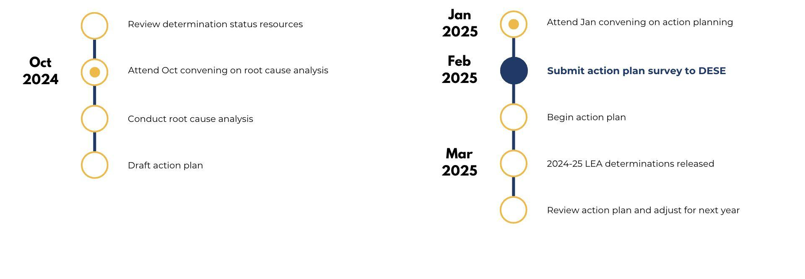
Timeline for NA Districts
Notes:
Per my earlier note about this being a tiered system of support, the timeline for NA districts is a lighter version of what we just walked through for NI districts. Additionally, while the convenings are highly recommended for NA districts, they are not required.
As with NI districts, NA districts should start by reviewing all the available resources to ensure they understand the rubric and their determination status. Then there is one-day root cause analysis convening, designed specifically for NA districts that you’re invited to attend in October.
Following the convening, your teams will go through the same process of conducting your root cause analysis and drafting your action plans. As with NI districts, we’ll make sure you leave the October convening with the resources, templates and guides to complete that work independently.
When you come back in January, you will also have a one-day convening in January to help you improve and finalize your action plans. Then in February, instead of submitting a full action plan to DESE like NI districts, you’ll complete an action play survey that shares similar information. This will enable DESE to see all of the areas NA districts are focused on and the kinds of action they’re taking, and will also provide a reference point they can refer to if your team reaches out for individual questions or support. And like I mentioned before, we will share the structure of that survey well in advance so you’ll know what it looks like and what information it entails.
Following the survey you’ll begin implementing your action plan. And then, as we just talked, about you’ll receive your 24-25 determination statuses in March and can begin reviewing your action plan and adjusting as necessary to prepare for the following year.
Okay, let me pause here for a moment and see if there are any questions about the timeline for Needs Assistance districts.

Slide 11
Next Steps
Notes:
Great! Well, with that, we’ll conclude with some practical next steps you can take following this webinar.

Slide 12

Next Steps 1-3
Review self-serve resources
Identify initial team members
Register your team for the convening
Notes:
First, make sure to review the resources we discussed, if you haven’t already. You’ll receive links to those in an following this call.
Second identify the 3-5 people you know want on the team that will be advancing this work. As we’ll discuss in our october convening, you’ll be expanding that team once you get into the root cause analysis work. But for now, find the 3-5 people you know you want driving this work from the very beginning.
Once you know those folks register your team for the October convening as soon as you receive your registration email. The maximum team size is 5, but you should plan to have at least 3 folks in attendance. You’ll see some guidance about the roles you’ll want to include in that registration link.
those are your main steps for right now! In advance of the convening we’ll email out with some pre-work you can do to come prepared to dig into your root causes but for now, all you need to do is identify your people and get registered!

Slide 13
Thank you!
Notes:
That concludes our time for today! I’ll end the recording now and folks are free to sign off, although the DESE team and I will stay on for a few more minutes if any folks have individual questions. But if you don’t have any questions, thank you again for joining and all the best as you start your school year!

