Slide 1
Topic 6 Local Task
8th Grade Civics

Slide 2
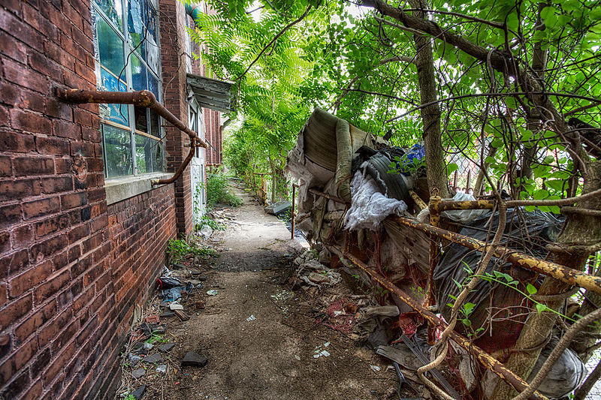
Handout 1 Activator Image
© John Hoey
Notes:
Image URL: https://commons.wikimedia.org/wiki/File:Keep_Out_(19024600109).jpg

Slide 3
Handout 1
Explain why the conditions around this abandoned factory may cause problems for city residents.
Describe one action that the local, state, and federal levels of government could each take to address the problem shown in the photograph.

Slide 4
Handout 2
Work with your group to read the information on Handout 2 and answer the questions on the handout.
Each student should complete their own handout.

Slide 5
Whole-Class Discussion
Why do you think the local government would be the best level of government to contact about this problem?
Why would the branch of government you chose be the best branch of government to address this problem?

