Slide 1
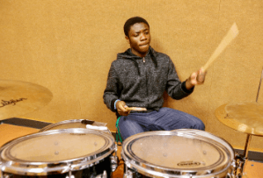
Page 1
Three Important Ways to put the Arts Framework into Practice
What is Artistic Intent?
Artistic intent is the meaning the artist intended in a work, so far as it can be determined from the artist’s statements or cultural context. Artistic intent can refer to a master artist or student artist.
What are Artistic Practices?
Artistic Practices are complex, multi-dimensional processes that are central to the creative process within the arts. The Massachusetts Arts Curriculum Framework has eleven Artistic Practices aligned directly to the National Core Arts Standards (NCAS). Based on the processes presented in the 2014 NCAS, these practices are grouped into four clusters that focus on creating, presenting/performing, responding, and connecting across the five arts disciplines.
Creativity:
Let Artistic Intent Drive the Lesson.
Identity:
Reflect Diverse Cultures, Values, & Experiences.*
Mastery:
Develop Artistic Practices.
An Interview with…
Allyn Phelps, Music Teacher, on How He Puts the Arts Framework into Practice
Allyn Phelps is an elementary music educator (K-6) in the Northborough Public Schools. He has a bachelor's degree from the University of Massachusetts Amherst and a master's degree from Boston University, where he is currently an on-campus doctoral student. His classroom practice and research focus include rethinking and designing elementary music education using democratic ideals to foster justice-oriented, student-led, and empowering learning. Find the transcript of this interview here.
Question 1: Can you share how you organize your music program to serve your students’ artistic intent?
Allyn Phelps:
Question 2: How did you come to this model of teaching and learning in the Arts?
Allyn Phelps:
Question 3: What student outcomes do you notice as a result of approaching instruction this way?
Allyn Phelps:
Question 4: Can you walk us through what a typical day looks like in your program?
Allyn Phelps:
School band member Albert Baraka (class of 2018) from North High in Worcester Public Schools.
How can performing arts teachers organize a program to serve students’ artistic intent and identity? How does that translate into mastery of content?
It is important to have an open-ended curriculum designed for student voice and lessons structured for divergent thinking. This allows students to pursue their own ideas and make choices in service of them. A student’s culture and identity are crucial drivers of artistic intent, so the classroom climate must recognize culture as a major asset for learning in the arts. Providing students with the opportunity to pursue artists, artworks, and genres of art that appeal most to them is a helpful way to center student identity. This creates a space for authentic inquiry for both teachers and students. To teach for mastery, learning should align to the artistic practices and supporting content standards, which require students to grapple with rigorous concepts and skills in order to successfully execute their artistic ideas.
1
From the Framework
Guiding Principle 5: An effective arts education provides students with broad and frequent access to great works of art from the past and present, across genres, time periods, and styles, and represents diverse cultures in the United States and from around the world in order to develop an appreciation for the richness of artistic expression, understand the connections between art and history, and cultivate one’s own sense of beauty.

Slide 2
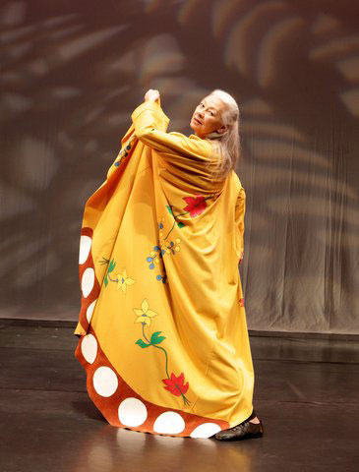
About
How to use Dance exemplars to emphasize Creativity, Identity, and Mastery
Case Study: Daystar Rosalie Jones
Main Contributor: Steve Aldeus
Daystar Rosalie Jones was born on the Blackfeet Reservation in Montana and is of Pembina Chippewa ancestry, specifically of Little Shell, on her mother's side. (Her mother was Susan Big Knife). In 1980 she created Daystar Contemporary Dance Drama of Indian America. This dance company was the first of its kind to create and perform Native American storytelling theater, which is now known as Modern Native dance. Her dance company was the first of its kind to create and perform "indigenous storytelling theater." This art form takes the traditional styles of dance and stories, and then interprets them for a contemporary audience. "Native American people have volumes to speak not only to non-Indian society but to each other as well. I feel that all of us, Indian and non-Indian alike, could benefit, especially now, from Native American philosophy and life experience" ( Jones, 1999).
Facilitative Questions
What are the characters in this performance doing?
What elements, costumes, and props are in this performance? How are they relevant to the story?
How does this performance help you understand more about the culture of the characters?
“What can we teach about ourselves to others through the medium of performance?“ (Jones, qtd. In Rafferty)
Aligning to the Arts Standards to Develop Student MASTERY
Lesson Starter (Aligned to 3rd-4th Grade level; Can be modified for all grade levels)
Students learn about Native American mythology and culture by exploring the dance works of Daystar Rosalie Jones. The class prepares their own production using a curriculum designed by Jones herself called “The Masked Dance Journey”. At the start of the lesson “an Indigenous story will be selected or created...” Characters and plot are explored by students in technique classes until the group “becomes familiar with the Indigenous cultural elements of the story and how these characters can be expressed in movement, song, character voice and word” (Daystar: Workshops…, n.d., para. 3). Finally, students engage in scene study to prepare a performance.
Content Standards
Respond to a movement challenge and hypothesize possible solutions (e.g., how to complete entrances and exits in a given space). (3-4.D.Cr.03)
Theatre Connection: Students employ physical theatre movements and modern dance gestures to tell a story. (3-4.T.Cr.03)
Analyze how different movement elements (e.g., space, time, effort) contribute to the meaning of a dance. (3-4.D.R.07)
HSS Connection: Students learn the meaning of various Native American powwow dances, such as the Eastern Blanket Dance or War Dance (HSS.3.T2.03).
Linked Resources
Daystar Rosalie Jones’ Website
Video Excerpt of “Allegory of the Cranes”
Using Artistic Practice to Examine CREATIVITY and IDENTITY
Planning Question: How does the practice of ‘Creating’ with artistic intent feature within this work?
Jones creates work focusing on indigenous storytelling theater that incorporates traditional and modern dance. Her work is important because each piece connects to a deeper theme that highlights indigenous traditions, history, and beliefs that she grew up with. Productions like "No Home but the Heart " highlight the social issues that many Native Americans, including Daystar’s family, went through. This piece focuses on how government intervention from 1837-1970 altered the lives of Native Americans in her family and community. Other productions like this "Allegory of the Cranes" are about identity and transformation and finding one's true self.
Daystar Rosalie Jones performing in “Allegory of the Cranes”. Photo courtesy of the artist.
2
References
IndianAmerica2012. (Jun 11, 2012). Daystar Rosalie Jones short bio (Interview) [Video]. YouTube. Retrieved December 23, 2020, from
https://www.youtube.com/watch?v=ftFw66bwltQ&t=30s
Trent University. (Jan 16, 2017). Indigenous studies-Daystar Rosalie Jones (Interview) [Video]. YouTube. Retrieved December 23, 2020, from
https://www.youtube.com/watch?v=TRRX8nBWqB8&t=12s
Rafferty, R. (December 25, 2019). Rochester 10: “Daystar” Jones. Retrieved December 23, 2020, from
https://www.rochestercitynewspaper.com/rochester/rochester-10-rosalie-daystar-jones/Content?oid=11203193
Jones, R.M. (n.d.). Daystar: Workshops & residences. Retrieved December 23, 2020, from http://www.daystardance.com/workshops_residencies.html

