Slide 1
Haverhill High School
Respect-Inclusion-Service-Equity
(An ML Multicultural & Diversity Afterschool Program)
Promoting Inclusivity and Empowerment for HS MLs
Spring 2024 Federal Grants Conference
May 13, 2024

Slide 2
HPS R.I.S.E. Team Members
Heidi Perez Director of MLE Education/Title lll Grant Writer/Manager
Eridania Nieves Intervention Support Technician HHS
Leydi Diaz Bilingual Career Tech Ed Recruiting Retention Specialist
Shawna Cruz Guidance Counselor
Armani Fiato Student Adjustment Counselor

Slide 3
Agenda
Introductions
HPS/HHS Demographic Data
R.I.S.E. Program
Program Evaluation Measures
Discussion and Questions

Slide 4
HPS/HHS Demographic Data

Slide 5
ML numbers are on the rise!
Census on 9-29-22 893
Census on 9-29-23 1037 13% increase in a year!
Census to Date: 1104
Year | % of MLs in Haverhill | % of MLs in MA
2023-2024 | 13% to date | 13.1% to date
2022-2023 | 11.4% | 12.1%
2021-2022 | 10.2% | 11%
2020-2021 | 9.6% | 10.5%
2019-2020 | 9.6% | 10.8%
2018-2019 | 9.5% | 10.5%

Slide 6
HPS/HHS Demographic Data
Year | Number of MLs | % of HS Population | Average Attendance | Graduation Rate
May 2024 | 239 /1957 | 12% |  | 41 MLs and FELs 22 On Track for D 18 On Track for COA 1 Promise 1 At Risk for DropOut
2022-2023 | 220/1993 | 10% | 80/7%MLs/85% HS | 60.8% 4 Year 85.4% 5 Year
2021-2022 | 100/1993 | 8.5% | 79.6%MLs/85% HS | 87.5% 4 Year 82.1% 5 Year
2020-2021 | 140/1885 | 7.5% | 75.4%MLs/87.5% HS | 64.3% 4 Year 88% 5 Year

Slide 7
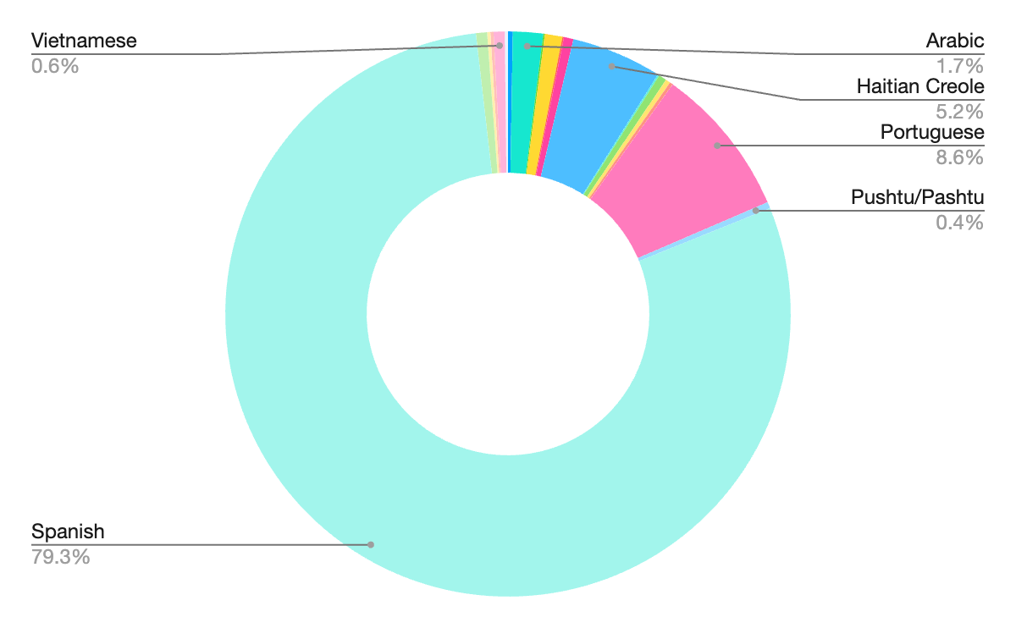
MLs First Languages

Slide 8
Multilingual Learners in HHS
Early College: 39 FEL and ML students enrolled this year
Visual, Performing, and Media Arts
MLs are well represented in all visual, performing, and media arts classes.
MLs participate in the annual District Art Show.
This year, several MLs submitted artwork for the Boston Globe Scholastic Arts & Writing Awards.
CVTE: 30 MLs enrolled.
ROTC: 30 MLs enrolled.
HHS Sports Teams: We have 68 Multilingual Learners on sports teams this year.
New SLIFE Program Track: Students with Limited or Interrupted Schooling

Slide 9
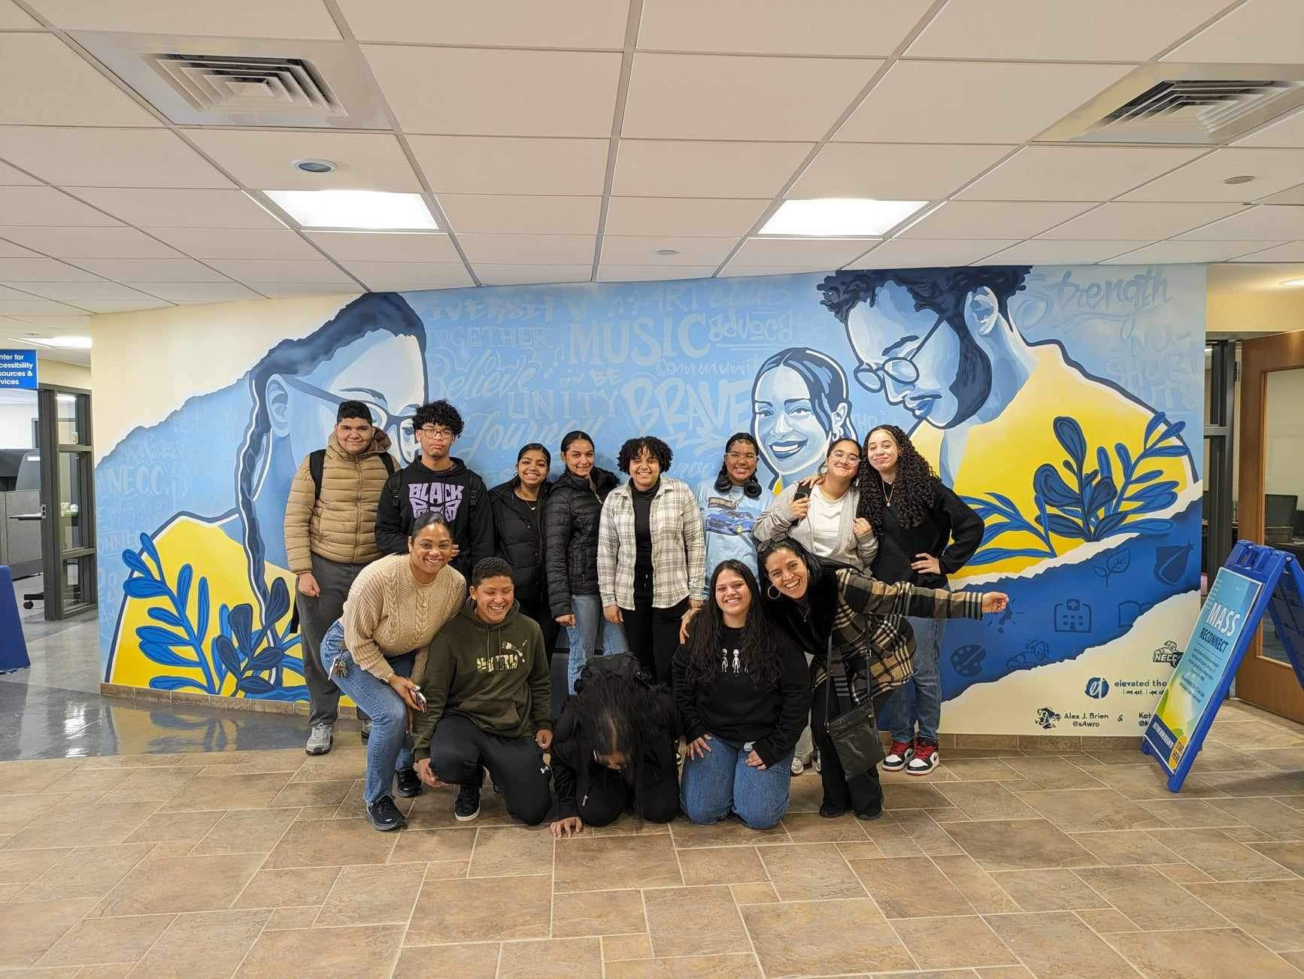
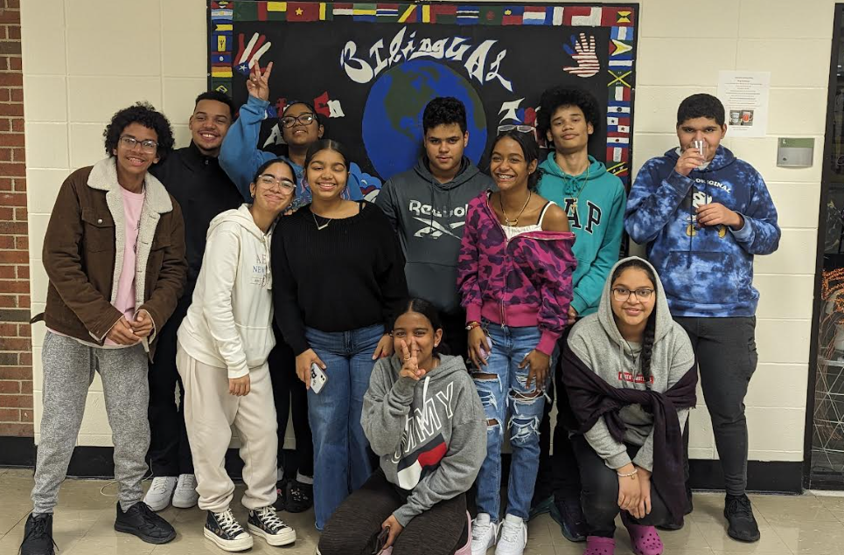
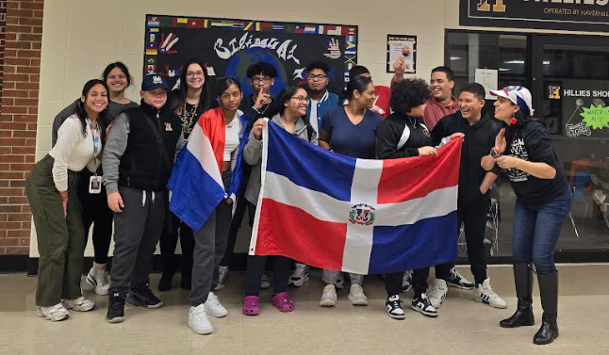
R.I.S.E. Program Goal
The main focus of program RISE is to support and guide high school ML students in the different aspects that will ensure their successful integration into American society, education system, and workforce.

Slide 10
R.I.S.E. Program Components
Getting to know each other, establish program rules, goals & expectations, formal application & parental consent
Share & elicit student input for topics of interest and needed life skills-
Relationships
Goal Setting
Education and Language Development
Cultural Diversity
Conflict Resolution & Anger Management
Stress Reduction & Fitness
Money Management
Leadership & Social Responsibility
Career and post- secondary education exploration
Family Support
Field Trips to expand exposure, interest and knowledge of opportunities
Group celebrations and student recognition
Ongoing Tutoring and Academic support
Parent Support and Informational Sessions

Slide 11
Program Evaluation Measures
Through pre & pro program evaluations, students will demonstrate feeling safer and more supported
Students will set both short- and long-term goals
Participants will participate in 2 job interviews and applications
Participants will volunteer for a minimum of 2 community service opportunities or events
Students will show an increase in feelings of school connectedness
Will demonstrate improved outcomes in attendance and academic performance

Slide 12
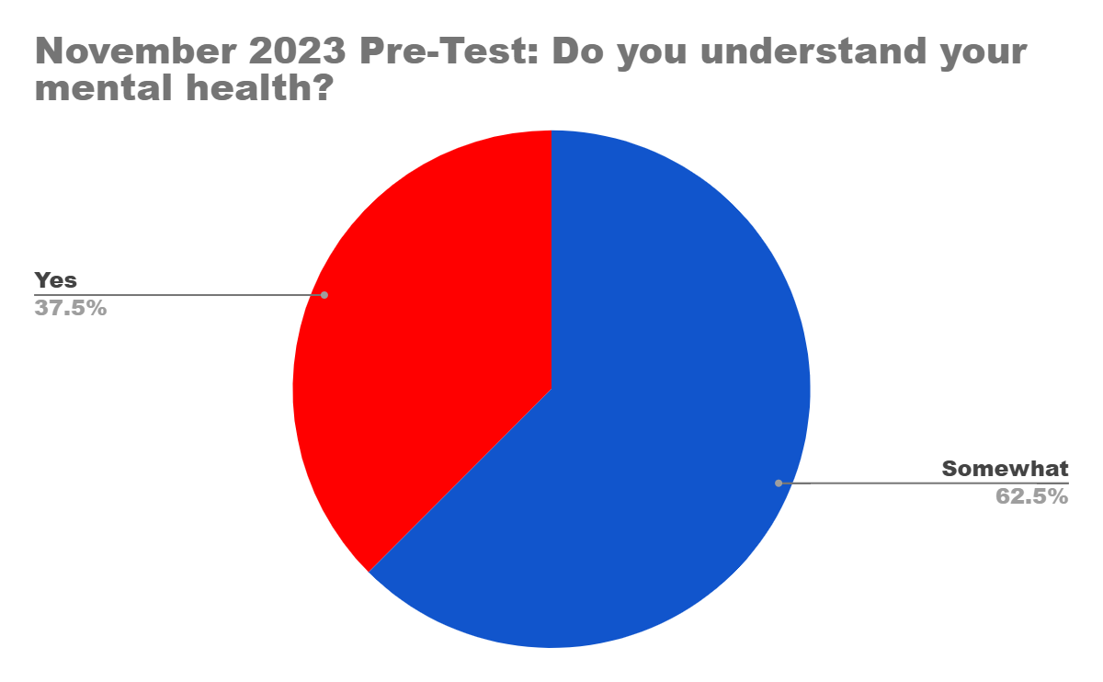
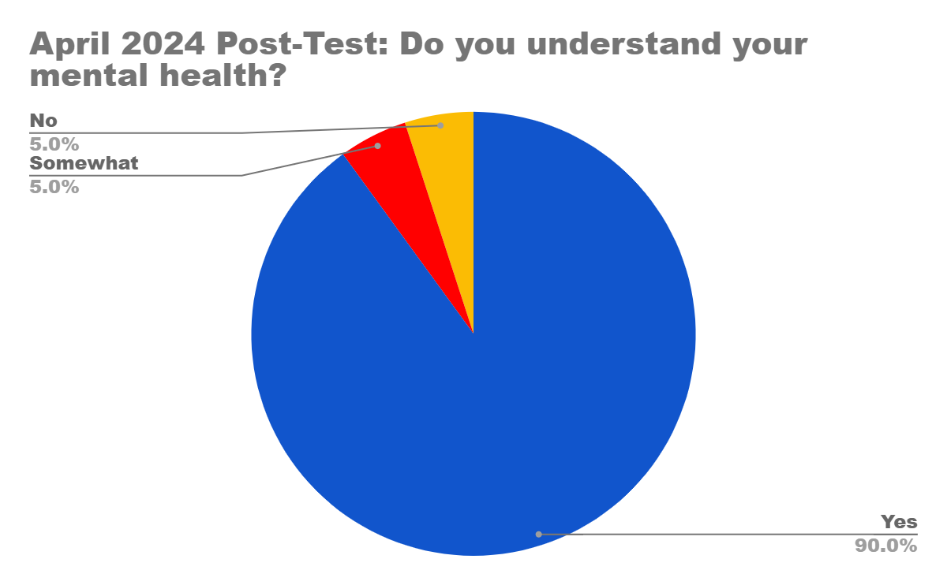
SEL in R.I.S.E.

Slide 13
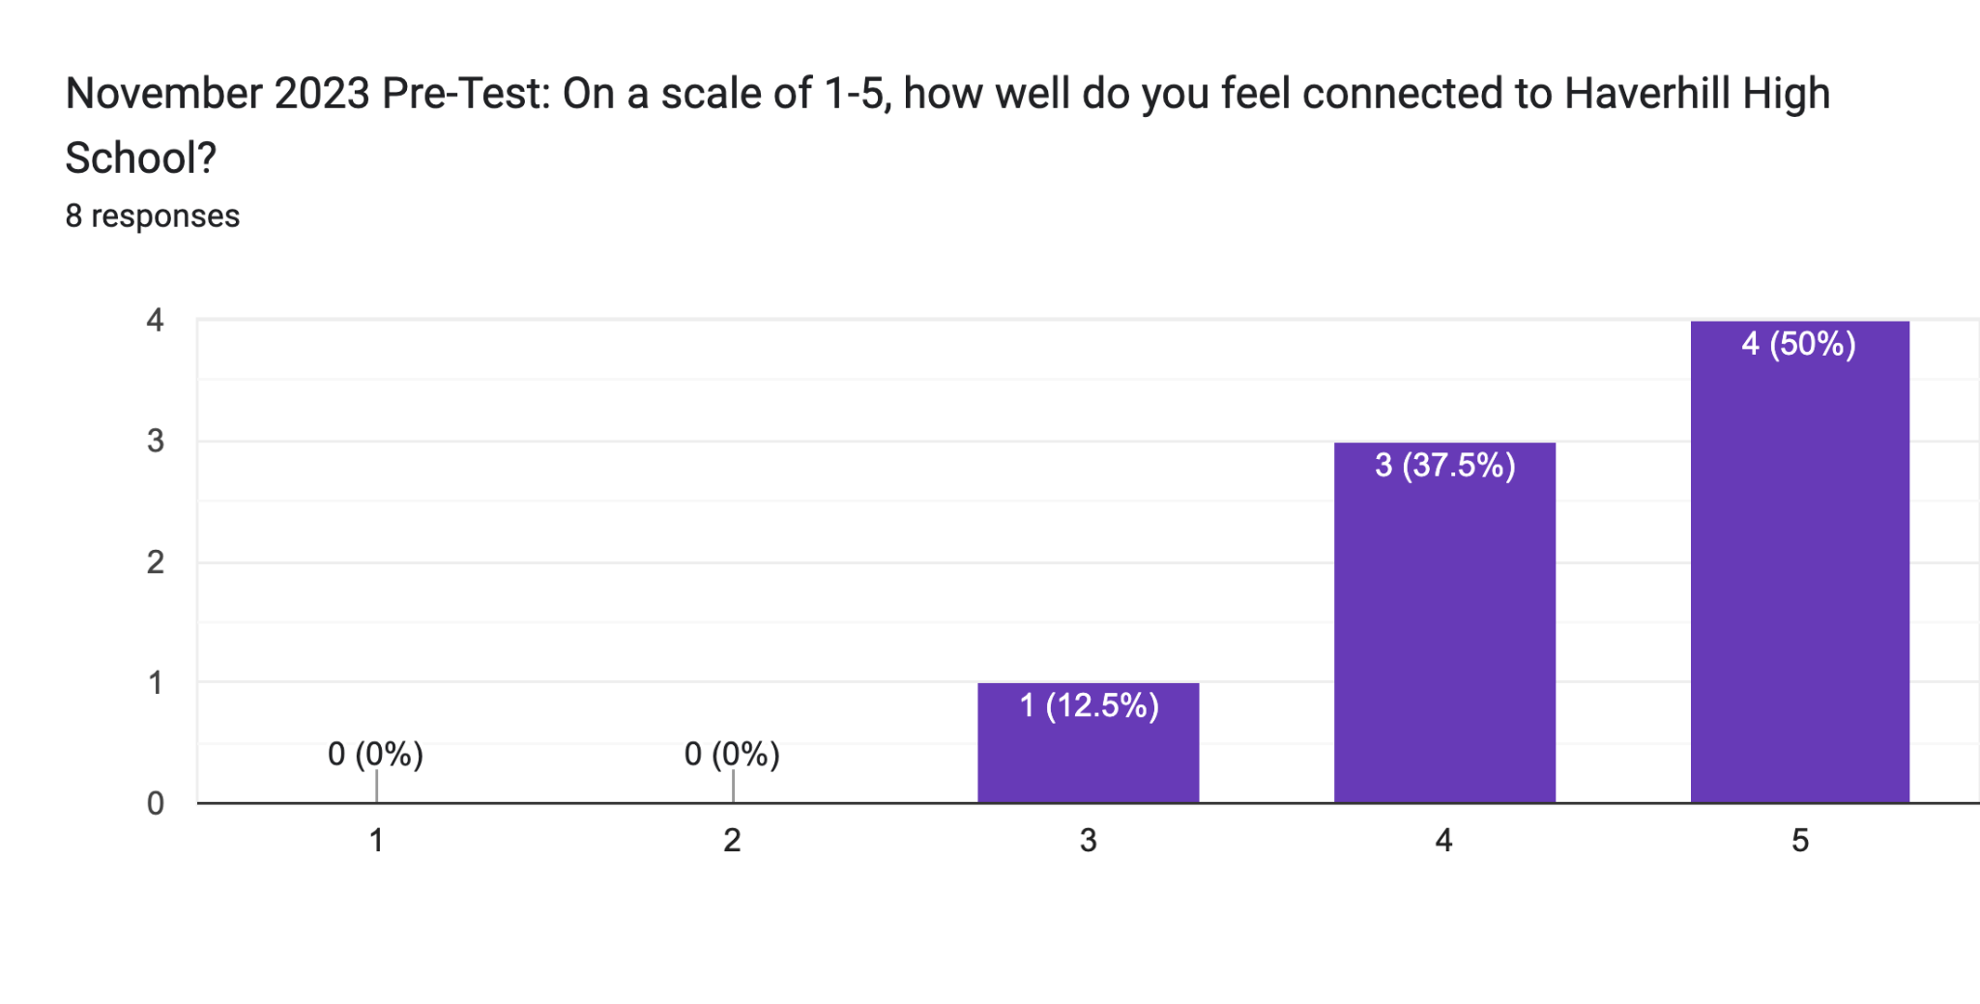
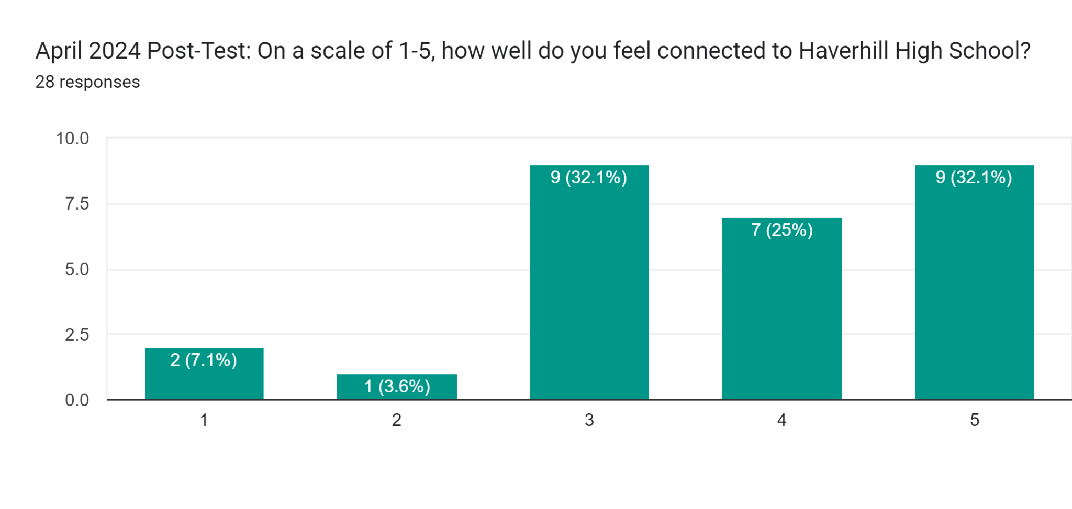
SEL in R.I.S.E.

Slide 14
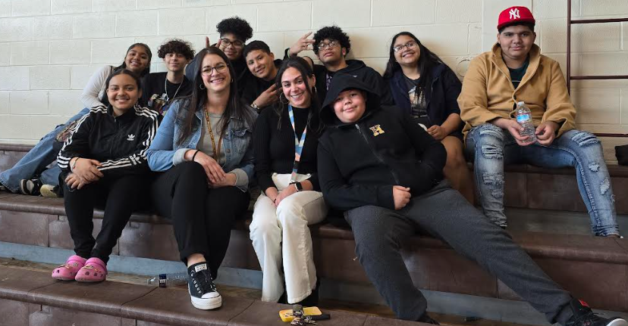
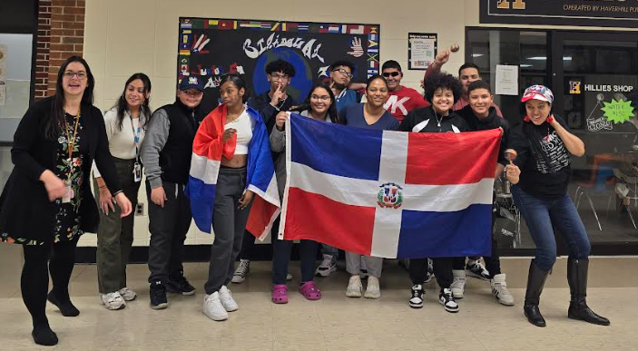
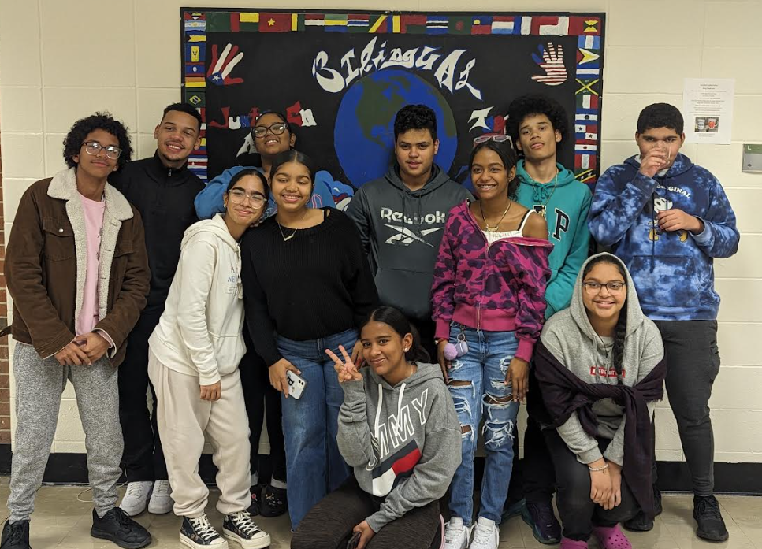
Photos

Slide 15
Students will show an increase in feelings of school connectedness
Wrap around services
Volunteering with Leaving the Street Ministry
Volunteering with Latino Coalition
Speaking in front of Haverhill School Committee
Celebrated Dominican and Haitian Independence Day
Pet a Reptile Day
Team building with Yonnie Collins from Haverhill School Committee
Eclipse watch party
Northern Essex Community College Campus Visit
Visit to the MA State House
Financial Literacy
Empanada Fundraiser
Substance abuse workshop
Connecting with the Haverhill Police Dept
Mental Health Workshops
Graduation requirement Workshops
Immigration Resources
School Committee Presentation
Access to in school food pantry/ Personal Hygiene

Slide 16
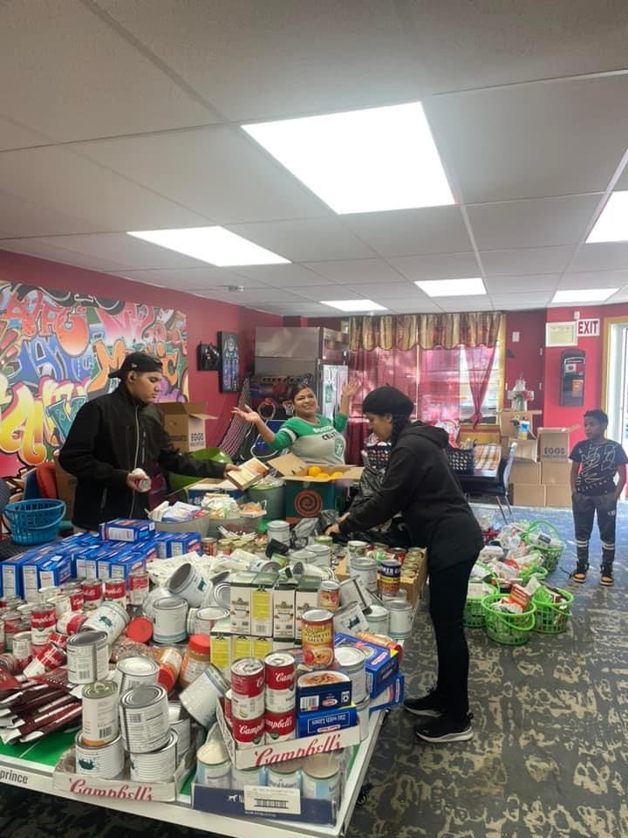
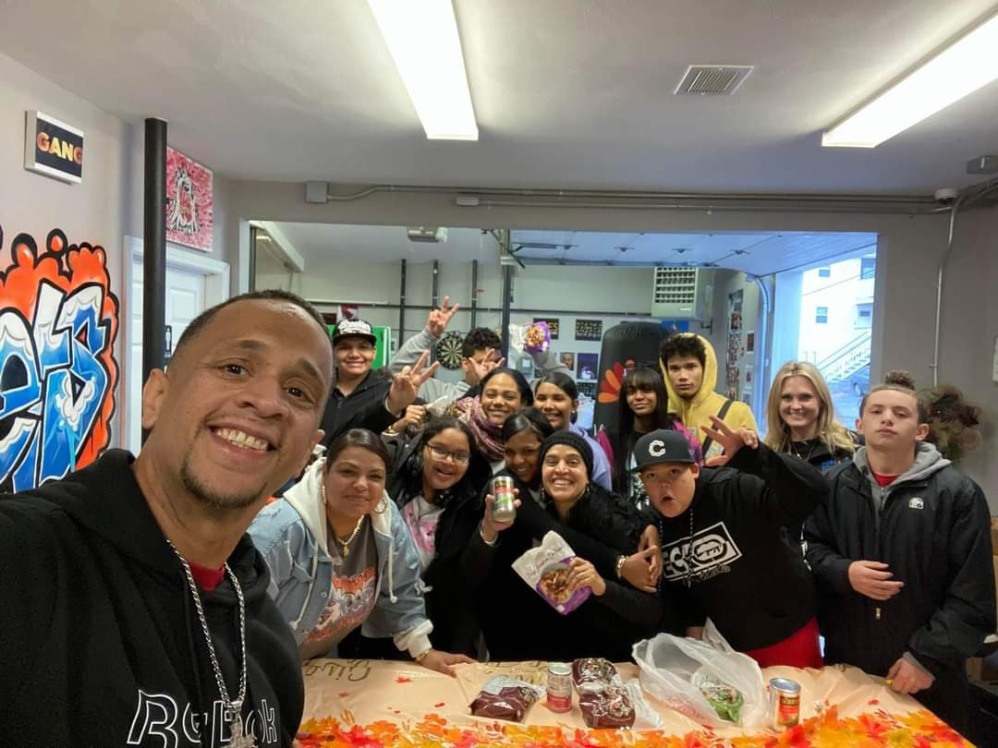
Participants will volunteer for a minimum of 2 community service opportunities or events
Students volunteered at the Leaving the Streets Ministry a Non- Profit organization in Haverhill, MA. They had the opportunity to give back to their community by putting together Thanksgiving baskets.

Slide 17
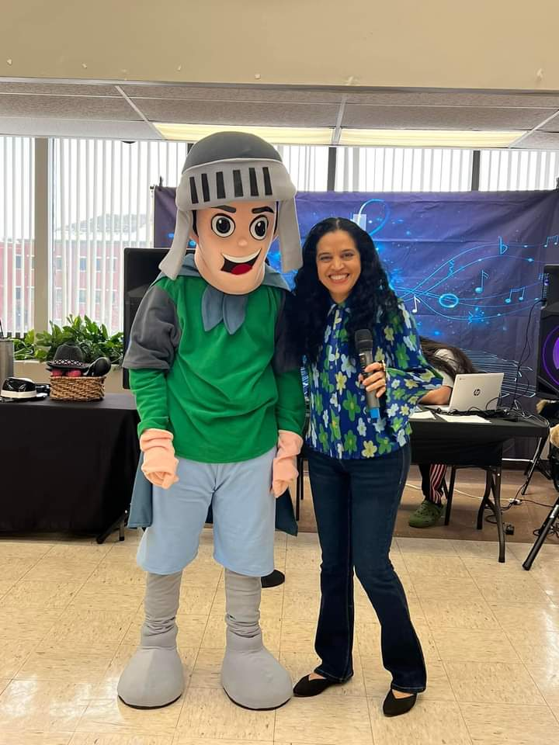
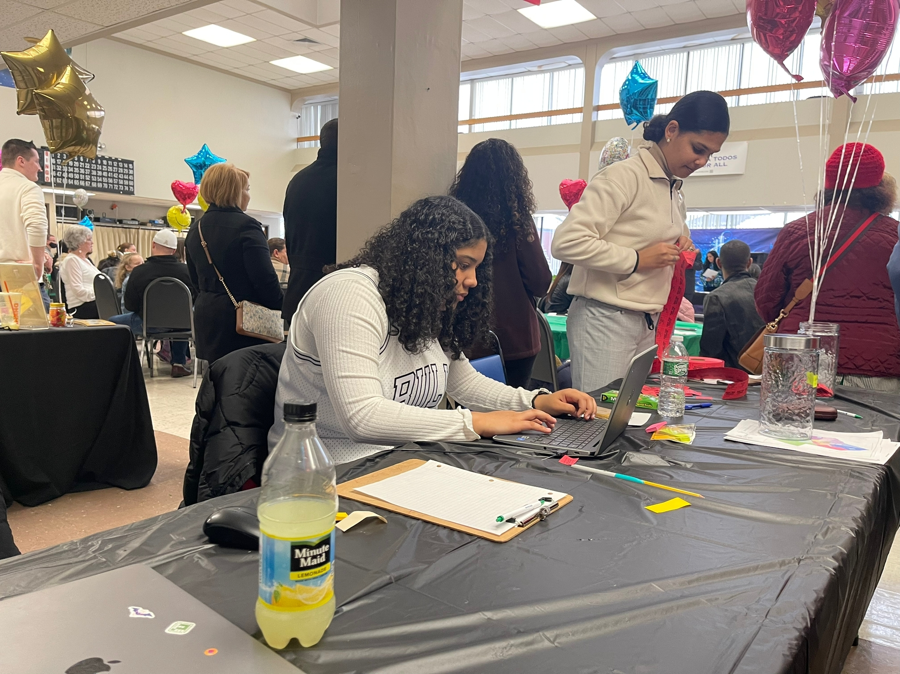
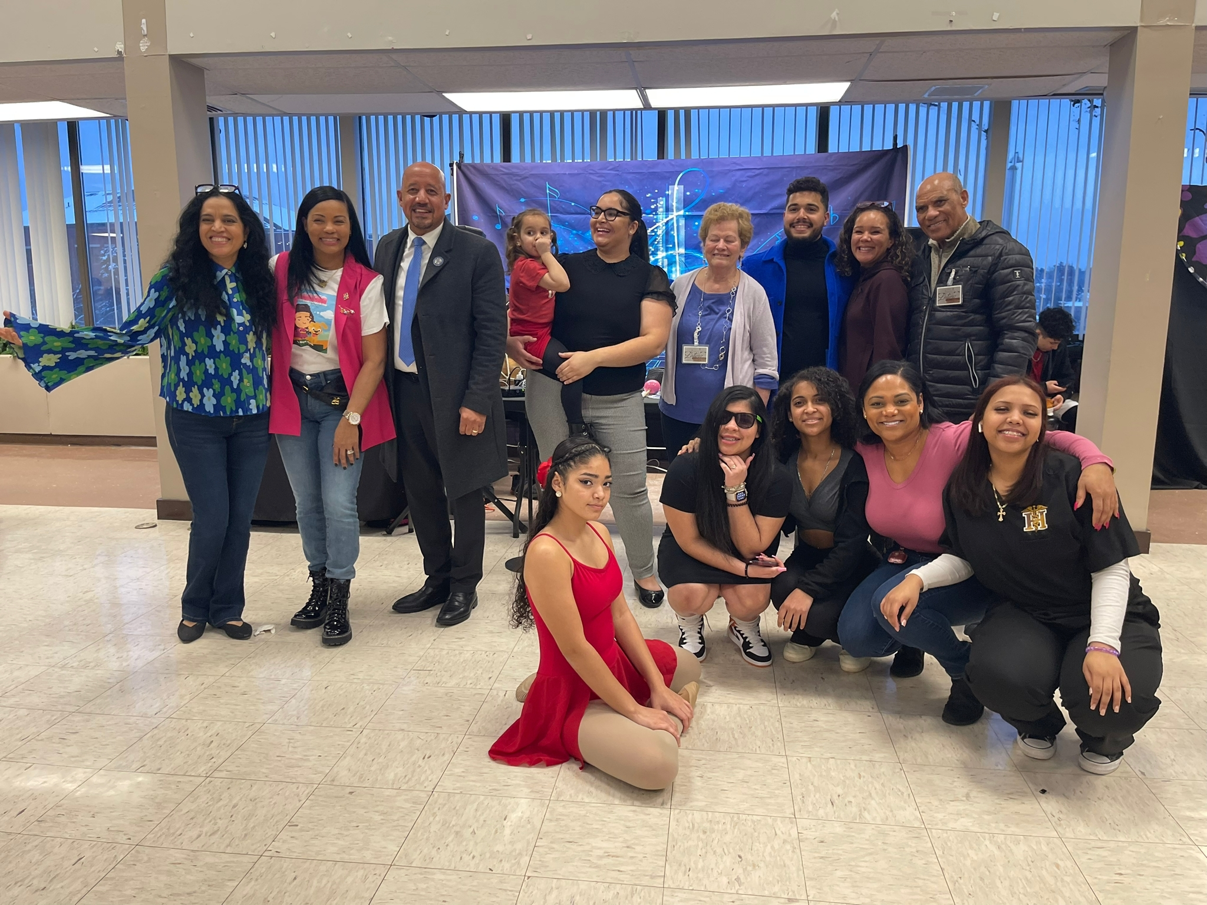
Participants will volunteer for a minimum of 2 community service opportunities or events
Let’s Celebrate Event by The Latino Coalition of Haverhill
A celebration of the Coalitions yearly accomplishments!

Slide 18
Will demonstrate improved outcomes in attendance and academic performance
25 ML students actively attend the program.
The average daily attendance rate for MLs at HHS is 91% HHS has a lower attendance rate for all students.
80% of the MLs participating in R.I.S.E made progress on ACCESS this year.

