Slide 1
Program Evaluations and Ensuring Compliance
Tiffany Kesslar, Esq.
tkesslar@bruman.com
www.bruman.com
May 2024

Slide 2
Program Evaluation Requirements
Cross-Cutting Requirements
Program Specific Requirements
Education Department General Administrative Regulations/Uniform Grants Guidance (2 CFR Part 200)
Self-assessments
Internal controls review
Elementary and Secondary Education Act
Statutory requirements
The Bruman Group, PLLC © 2024. All rights reserved.

Slide 3
Cross-Cutting Evaluation Requirements
EDGAR/UGG Requirement
Self-Assessment 2 CFR 200.329
Recipients and subrecipients must conduct a self-assessment!
Monitor its activities under Federal awards to assure compliance with applicable Federal requirements and performance expectations are being achieved.
Monitoring must cover each program, function or activity.
The Bruman Group, PLLC © 2024. All rights reserved.

Slide 4
Cross-Cutting Evaluation Requirements (cont.)
EDGAR/UGG Requirement –
Internal Controls 2 CFR 200.303
The non-Federal entity must:
Establish, document, and maintain effective internal control over the Federal award that provides reasonable assurance that the non-Federal entity is managing the Federal award in compliance with Federal statutes, regulations, and the terms and conditions of the Federal award.
The Bruman Group, PLLC © 2024. All rights reserved.

Slide 5
Cross-Cutting Evaluation Requirements (cont.)
Comply with requirements (including U.S. Constitution)
Evaluate and monitor compliance
Take prompt action to correct noncompliance
Take reasonable cybersecurity and other measures to safeguard information including personally identifiable information (PII) and other types of information.

Slide 6
Program Specific Evaluation Requirements
ESEA Title I, A LEA Requirements
Sec. 1114(b)(3) – Schoolwide Programs
“the plan and its implementation shall be regularly monitored and revised as necessary based on student needs to ensure that all students are provided opportunities to meet the challenging State academic standards”
Sec. 1115(b)(2)(G) – Targeted Assistance Programs
“the school will…on an ongoing basis, review the progress of eligible children and revise the targeted assistance program under this section”
Sec. 1116(a)(2)(D) – Parent and Family Engagement
The LEA “will conduct, with the meaningful involvement of parents and family members, an annual evaluation of the content and effectiveness of the parent and family engagement policy”
The Bruman Group, PLLC © 2024. All rights reserved.

Slide 7
Program Specific Evaluation Requirements (cont.)
ESEA Title I, A LEA Requirements (cont.)
Sec. 1117(a)(1)(A) – Equitable Services
The LEA shall provide “evaluations to determine the progress being made in meeting such students’ academic needs”
ESEA Title II, A LEA Requirements
Sec. 2102(b)(2)(D)– Subgrants to Local Educational Agencies
“Each application submitted …shall include the following…(D) A description of how the local educational agency will use data and ongoing consultation described in paragraph (3) to continually update and improve activities supported under this part.”
Sec. 2103(a) – Local Uses of Funds
“A local educational agency that receives a subgrant under section 2102 shall use the funds made available through the subgrant to develop, implement, and evaluate comprehensive programs and activities.
The Bruman Group, PLLC © 2024. All rights reserved.

Slide 8
Program Specific Evaluation Requirements (cont.)
ESEA Title II, A LEA Requirements (cont.)
Sec. 2102(b)(2)(D)– Subgrants to Local Educational Agencies
“Each application submitted …shall include the following…(D) A description of how the local educational agency will use data and ongoing consultation described in paragraph (3) to continually update and improve activities supported under this part.”
Sec. 2103(a) – Local Uses of Funds
“A local educational agency that receives a subgrant under section 2102 shall use the funds made available through the subgrant to develop, implement, and evaluate comprehensive programs and activities.
The Bruman Group, PLLC © 2024. All rights reserved.

Slide 9
Program Specific Evaluation Requirements (cont.)
ESEA Title II, A LEA Requirements (cont.)
Sec. 2103(a) – Local Uses of Funds
Types of Activities may include:
developing or improving a rigorous, transparent, and fair evaluation and support system
shall include multiple measures of educator performance
the development and provision of training for school leaders, coaches, mentors, and evaluators on how accurately to differentiate performance, provide useful feedback, and use evaluation results to inform decision making about professional development, improvement strategies, and personnel decisions; and
a system for auditing the quality of evaluation and support systems;
developing feedback mechanisms to improve school working conditions, including through periodically and publicly reporting results of educator support and working conditions feedback
The Bruman Group, PLLC © 2024. All rights reserved.

Slide 10
Program Specific Evaluation Requirements (cont.)
ESEA Title III, A LEA Requirements
Sec. 3121 – Reporting
the number and percentage of English learners in the programs and activities who are making progress toward achieving English language proficiency
any other information that the State educational agency may require
State must ensure that LEAs “annually assess the English proficiency of all English learners participating” in Title III,A
ESEA Title IV, A LEA Requirements
Sec. 4106 – Local Educational Agency Applications
The plan shall include “the program objectives and intended outcomes for activities under this subpart, and how the local educational agency, or consortium of such agencies, will periodically evaluate the effectiveness of the activities carried out under this section based on such objectives and outcomes.”
The Bruman Group, PLLC © 2024. All rights reserved.

Slide 11
Evaluation and Performance Oversight
The Bruman Group, PLLC © 2024. All rights reserved.

Slide 12
U.S. Department of Education Oversight
ED/RMS Risk Approach – The Entity Risk Report (ERR)
ERR is ED’s Pre-Award Risk Assessment Rubric Use by Grants Risk Management Service (GRMS)
Incorporates information from multiple data sources
Focuses on both compliance and performance
Used by both RMS and the Office of the Inspector General (OIG)
RMS uses ERR looking forward
OIG uses ERR looking backward
Some program offices utilized the ERR, others have their own rubric.
The Bruman Group, PLLC © 2024. All rights reserved.

Slide 13
U.S. Department of Education Oversight (cont.)
Office of Elementary and Secondary Education (OESE)
Monitoring Effectiveness
SW: Funds are to support the effective implementation of schoolwide programs…
TAS: How does the SEA ensure that LEAs and schools implementing targeted assistance programs that use nonprofit or for-profit external providers to deliver services demonstrate expertise in using evidence-based or other effective strategies to improve student achievement?
Parent and Family Engagement: effective parent and family engagement strategies…
The Bruman Group, PLLC © 2024. All rights reserved.

Slide 14
DESE - Pass-Through Entity Oversight 200.331(b) and (d)
Pass-through must evaluate each subrecipient’s risk of non compliance for purposes of determining appropriate monitoring.
Pass-through must monitor its subrecipients to assure compliance and performance goals are achieved.
Must include:
Review financial and programmatic reports
Ensure corrective action
Issue a “management decision” on audit findings
The Bruman Group, PLLC © 2024. All rights reserved.

Slide 15
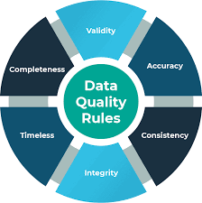
Data Quality
The Bruman Group, PLLC © 2024. All rights reserved.

Slide 16
OESE Data Quality Oversight
How do you ensure the data reported are of high quality (i.e., timely, complete, accurate)?
Periodic monitoring?
Check processes and forms to collect data?
Ensure proper dissemination?
Provide enough time for input?
Reaching out to the correct participants/staff?
How do you resolve data quality issues that the district identifies through its data quality process?

Slide 17
OESE Data Quality Oversight (cont.)
Documentation may include:
Business procedures and policies for identifying systemic or systematic data quality issues
Checks in place in the data system that raise potential errors?
Checks that roll up data and compare counts and rates at various levels? etc.
Policies and procedures for reviewing data submitted by schools
Sample LEA management certification form or certification language

Slide 18
OESE Data Quality Oversight (cont.)
Does the data support the conclusions?

Slide 19
How to Review Your Evaluation Process – Conduct a Self Assessment
The Bruman Group, PLLC © 2024. All rights reserved.

Slide 20
Self Assessment Process
Clear agency objectives;
Program Compliance, Performance metrics
Review applicable documentation
Interviews/discussion
Identify risks/noncompliance
Assess changes that could significantly impact the system.
Staff turnover, geographic boundary changes, funding changes, etc.
Mitigation/ corrective action
Repeat
The Bruman Group, PLLC © 2024. All rights reserved.

Slide 21
Step 1: Identification
Identify Areas to Assess:
Funds are not being spent
Areas with complaints
Prior audit/monitoring findings
Especially repeat findings
Ongoing corrective actions
Sections monitored by USDE or DESE
Areas that auditors will test
OMB Compliance Supplement
The Bruman Group, PLLC © 2024. All rights reserved.

Slide 22
Step 2: Review Documentation
Needs assessments
Feedback on program performance
Evaluation forms, general data on performance, committee of practitioners
Policies and procedures
Compliance with federal rules, reflect actual practices
Job descriptions and organizational chart
Who is responsible for evaluation and oversight of it?
Most recent audit/monitoring reports
Current or recently completed corrective action plans
The Bruman Group, PLLC © 2024. All rights reserved.
Notes:
Tons of resources – National center for education Statistics has Data Quality reports on the role of the teacher, school staff, board members, etc.
https://nces.ed.gov/forum/pub_2005801.asp

Slide 23
Step 2: Review Documentation (cont.)
Data Reliability
Must ensure the data you are using is accurate and reliable.
ED Data Quality: https://oese.ed.gov/resources/oese-technical-assistance-centers/state-support-network/communities-of-practice/data-quality/
Data Systems: https://oese.ed.gov/resources/oese-technical-assistance-centers/state-support-network/communities-of-practice/data-systems/
The Bruman Group, PLLC © 2024. All rights reserved.

Slide 24
Step 3: Interviews/Discussions
Identify relevant staff/persons
Program-specific staff (allowability, eligibility, reporting)
LEA central staff
School level staff
Third-party / Contractors
Beneficiaries
Interview staff on evaluation and performance practices
Current practices (outreach, data collection, analysis, etc.)
Processes around planning upcoming year activities based on evaluation data
Familiarity with policies & procedures
Relevant audit/monitoring findings
Status of any corrective actions
The Bruman Group, PLLC © 2024. All rights reserved.

Slide 25
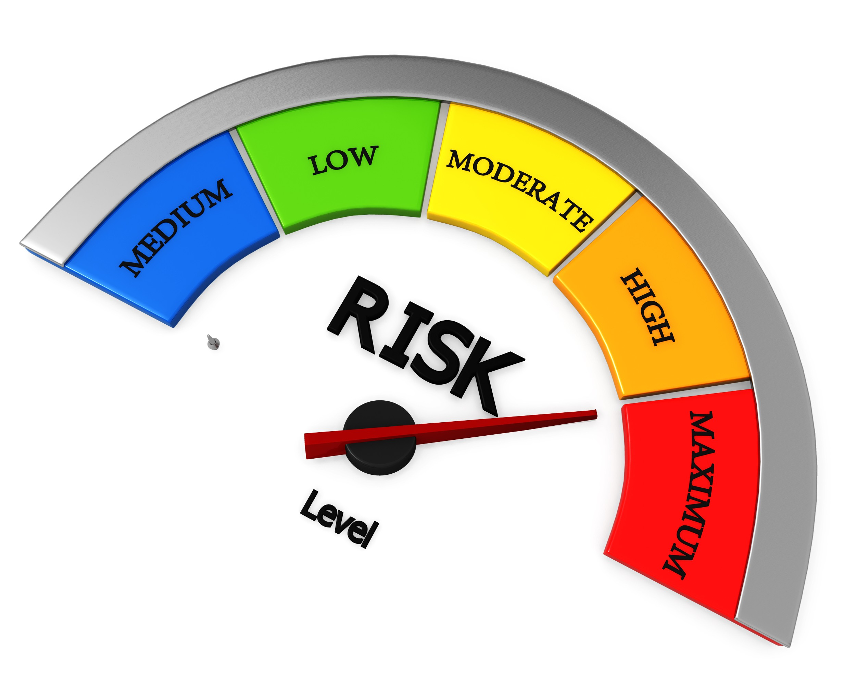
Step 4: Identify Risks/Noncompliance
Risks are not stagnate; they increase and change as operational environments change.
Examples:
Changes in Laws and Regulations
Geographical changes
Staff turnover
Changes in population
Data reliability
Difficulty accessing beneficiaries
Repeat participants
The Bruman Group, PLLC © 2024. All rights reserved.

Slide 26
Step 5: Mitigation/ Corrective Action
If not the best use of funds - change current practices!
Create and implement different/new activities.
e.g., Training on requirements/expectations/objectives, Segregation of duties, Expanding evaluation feedback options, etc.
Update policies and procedures.
Deploy control activities through polices that establish what is expected and procedures that put policies into action.
The Bruman Group, PLLC © 2024. All rights reserved.

Slide 27
Step 5: Mitigation/ Corrective Action (cont.)
If noncompliant: draft and implement Corrective Action Plan (CAP)
Don’t wait until auditor or monitoring team is onsite
CAP must focus on specific activities to mitigate identified risk(s)
Specific Measurable Objectives
Timelines
Clear Lines of Responsibility
Ensure corrective actions are completed!
The Bruman Group, PLLC © 2024. All rights reserved.

Slide 28
Step 5: Mitigation/ Corrective Action (cont.)
Have clear agency and program goals and objectives:
A clear commitment to integrity and ethical values;
Independent oversight over the development and performance of internal controls;
Clearly defined organizational structure, clear reporting lines, appropriate authorities;
A commitment to attract, develop and retain competent individuals; and
Maintain a level of competence that allows personnel to accomplish their assigned duties (and holding individuals accountable)
28
The Bruman Group, PLLC © 2024. All rights reserved.

Slide 29
Step 5: Mitigation/ Corrective Action (cont.)
Deploy clear communication and information:
Obtain or generate or use relevant, quality and consistent information to support the functioning of the district;
Internally communicate info, including objectives and responsibilities necessary to support the entity; and
Clearly and consistent communications with external parties re: expectations, goals, etc.
The biggest difficulty with communication is the belief that it has occurred.
The Bruman Group, PLLC © 2024. All rights reserved.

Slide 30
Self-Assessment Step 6: Repeat!
Self-Assessment is ongoing
The Bruman Group, PLLC © 2024. All rights reserved.

Slide 31
Any Questions?

Slide 32
Legal disclaimer
This presentation is intended solely to provide general information and does not constitute legal advice or a legal service. This presentation does not create a client-lawyer relationship with The Bruman Group, PLLC and, therefore, carries none of the protections under the D.C. Rules of Professional Conduct. Attendance at this presentation, a later review of any printed or electronic materials, or any follow-up questions or communications arising out of this presentation with any attorney at The Bruman Group, PLLC does not create an attorney-client relationship with The Bruman Group, PLLC. You should not take any action based upon any information in this presentation without first consulting legal counsel familiar with your particular circumstances.
The Bruman Group, PLLC © 2023. All rights reserved.

