Slide 1




Early Literacy Consortium Grant
FY2025 FC726
Office of Educator Effectiveness,
Center for Instructional Support

Slide 2

Agenda
01
Overview
02
Application Process
03
Budget Information
04
Q and A

Slide 3





Overview of the
Grant’s Purpose
The grant is designed to fund the development, launch, and continuation of partnerships between eligible Educator Preparation Programs and PK–12 districts that lead to ...
Improved teacher preparation in evidence-based, culturally and linguistically sustaining early literacy instruction
Improved student outcomes in early literacy
Improved literacy practices in PK-3 classrooms

Slide 4





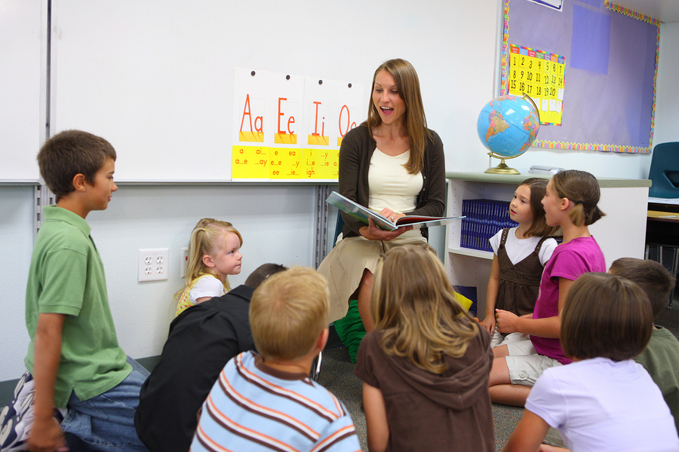
How can consortia reach those goals?
PK12 schools and sponsoring organizations can decide the best approach for their local context. While the mission of each consortium should stay focused on the three goals outlined in the grant, the ACTION PLAN for how to reach those goals may be very different.
Examples:
  Early literacy tutoring program
  Professional development for evidence-based early literacy
  Early Literacy Task Force

Slide 5




APPLICANT CATEGORIES
  Applicants may be a various stages in the development of a consortium
Category One
Category Two
Category Three
Applicants in this category are at the very beginning stages of planning and have not firmly established multiple partnerships.
Applicants should represent a growing consortium that includes at least one district and at least one sponsoring organization.
Applicants in this category have established partnerships in their region and are designing and planning to implement programming that will advance effective early literacy instruction.
Applicants should represent a growing consortium that includes at least two districts and at least two sponsoring organizations.
Applicants in this category represent an established partnership with a clear, strategic plan for the consortium's work. The consortium has already launched an early literacy program and plans to grow that program.
Applicants should represent at least two districts and at least two sponsoring organizations.

Slide 6


Other Considerations
It can be challenging to organize a joint application to a state grant; be clear up front about who is the point person for collecting forms and disseminating information.
The award is given to ONE partner in the consortium (the partner who officially applies for the grant). That partner is responsible for allocating funds to the other districts and EPPs – it is up to the applicant’s finance department to determine the best approach for this.
If awarded, your consortium commits to meeting with DESE staff once a month to share progress and ask questions.
Sales
If awarded, your consortium commits to convening representatives from ALL partners – the intention is for all partners to have a voice in decision-making.

Slide 7





Application Process
01
Login to DESE’s new Grant Management Platform: GEM$
(contact: EdGrants@mass.gov)
Overview
Work with partnering districts or sponsoring organizations to complete all grant assurances, answer all narrative prompts, and create a detailed budget for your consortium.
02
03
Submit all application materials by 5:00 pm on October 11, 2024 on GEM$.
Once your application is approved by the governor’s office, you will be notified and can begin drawing down funds.
04

Slide 8
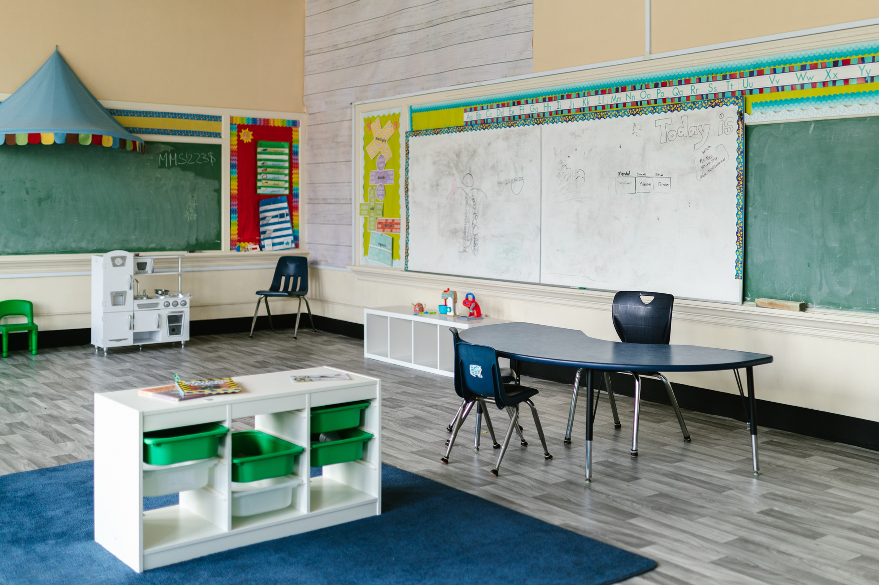



A note about the timeline for funding
  August 2025
FY25 deadline for reporting fund use
  June 30, 2025
FY25 deadline for spending down funds.
  January
Application Approval and Award
The Governor's Process for Approval can take 6 – 12 weeks. If approved, your “spending window” would be from the date the application is due (Oct 11) to the end of the fiscal year (June 30)
October
Application due

Slide 9

Questions?
Email the Assistant Director of Literacy, Linda Sewnarine (linda.sewnarine@mass.gov) or check out the FAQ on the Early Literacy in Educator Preparation Webpage

Slide 10


THANK YOU
This Photo by Unknown Author is licensed under CC BY-SA

