Slide 1
Educator Evaluation
Overview for MA Educators and Evaluators
Notes:
Key points:
This presentation is provides an overview for Massachusetts school-based educators and evaluators on key priorities and recommendations for educator evaluation.
It outlines Focus Indicators on which educators and evaluators can prioritize feedback and support, includes high-level information on the “what, why, and how” of the five-step cycle, and names specific considerations for supporting and developing culturally responsive practice.
For more in-depth information on Educator Evaluation in Massachusetts, please see the following recommended resources: The Model System (online module) and Training Workshops for Teachers (both available here: https://www.doe.mass.edu/edeval/training-resources.html).

Slide 2
Objectives
This resource:
Outlines key priorities for implementing educator evaluation
Provides recommendations and best practices for leveraging the educator evaluation process to support educator growth and development and help foster more anti-racist, culturally responsive schools and classrooms, based on feedback from educators
Notes:
As we strive to create more equitable, culturally responsive schools and classrooms for all, this resource supports educators and evaluators to leverage the educator evaluation process to support meaningful supervision, feedback, and evaluation practices.

Slide 3
Acknowledgements
The 2020-2021 and 2021-2022 Teacher and Principal Advisory Cabinets provided invaluable feedback and insights into culturally responsive practices in educator evaluation that directly informed the development of the 2021-22 Educator Evaluation Implementation Resources and updates to the Model Rubrics.
The 2021 OPTIC Content Fellows supported the development of resources to build understanding of culturally responsive teaching aligned to focus elements from the Model Classroom Teacher Rubric.
In partnership with the Massachusetts Association of School Superintendents (M.A.S.S.), district leaders from across Massachusetts participated in focus groups to share feedback on their experiences with educator evaluation before and during the COVID-19 pandemic.
Notes:
Additional resources:
Teacher and Principal Advisory Cabinets: https://www.doe.mass.edu/amazingeducators/cabinets/
OPTIC Content Fellows/Calibration resources: https://www.doe.mass.edu/edeval/resources/calibration/

Slide 4
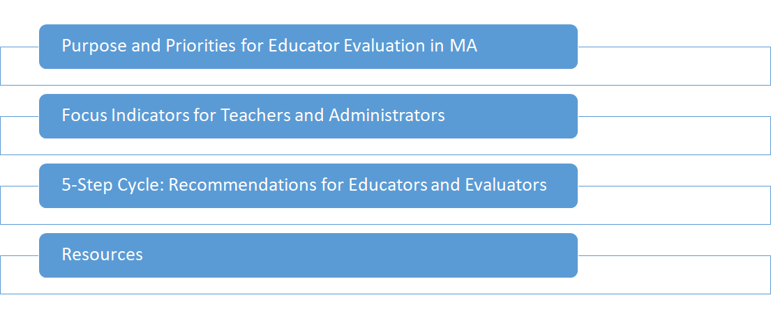
Contents

Slide 5
Purpose
The purpose of Educator Evaluation in Massachusetts is to ensure that each and every student has equitable access to excellent educators, by:
Promoting growth and development of teachers and administrators,
Placing student learning at the center, using multiple measures of student learning, growth and achievement,
Recognizing excellence in teaching and leading,
Setting a high bar for professional teaching status, and
Shortening timelines for improvement
Notes:
Key points:
The purpose of educator evaluation in Massachusetts is to ensure that each and every student has equitable access to excellent educators.
This resource outlines priorities and recommendations for implementing this framework in a way that is meaningful, supportive, and culturally responsive for all.

Slide 6
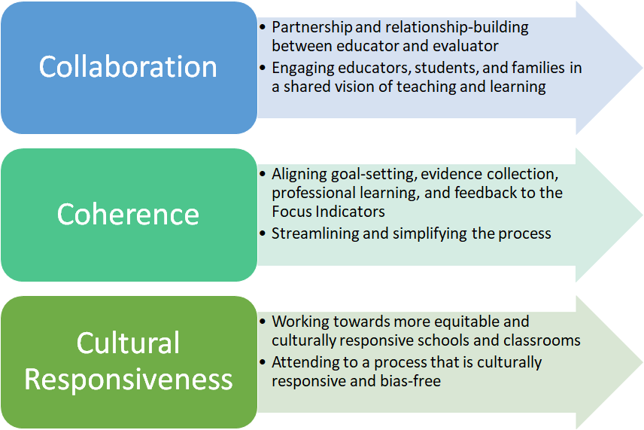
Implementation Priorities for 2021-22
Advancing equity and social justice in student outcomes
Notes:
Key points:
The 2020-21 Principal and Teacher Advisory Cabinets advised DESE on the characteristics of culturally responsive educator evaluation. From these conversations, several priorities emerged for implementation of the MA Educator Evaluation Framework:
Collaboration: Educator evaluation should be a collaborative, partnership-based process that promotes educator growth. This means prioritizing communication, building trusting relationships, and ensuring that the educator’s voice is heard.
Coherence: For educator evaluation to be meaningful and supportive, it should promote greater coherence between educator goals and school and district priorities. Aligning goal-setting, evidence collection, professional learning, and feedback to the 2021-22 Focus Indicators can promote a more streamlined, simplified, and supportive process.
Cultural Responsiveness: Educator evaluation can support efforts towards more equitable and culturally responsive schools and classrooms and should be implemented in a way that attends to a culturally responsive and bias-free process.
At the center, and guiding the work, is a focus on advancing equity and social justice in student outcomes.
Additional resources:
DESE’s Culturally Responsive Teaching and Leading: https://www.doe.mass.edu/instruction/crdw/
Teacher Evaluation as Cultural Practice: A Framework for Equity and Excellence by Maria del Carmen Salazar and Jessica Lerner)

Slide 7
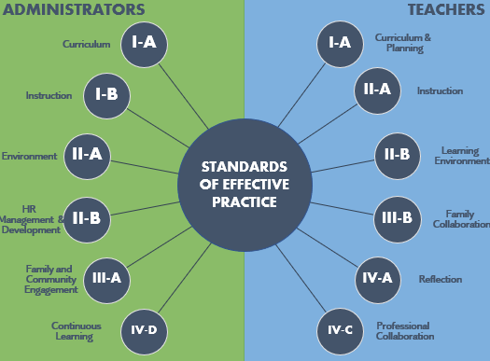
Focus Indicators
The Center for Instructional Support has identified six Focus Indicators for Teachers and Administrators representing the highest priority practices for the 2022-23 school year.
Aligning the educator evaluation cycle to the Focus Indicators will:
➔ Streamline supervision and evaluation
➔ Guide meaningful goal setting, and
➔ Focus feedback and support throughout the school year.
Notes:
Key points:
DESE has a longstanding recommendation to prioritize practices from the Model Rubrics for goal-setting, feedback, and professional learning.
In support of this, the Center for Instructional Support has identified six Focus Indicators for Teachers and Administrators representing the highest priority practices for the 2022-23 school year. These Focus Indicators have remained largely consistent since 2020-2021 as educators continue to address the disruptions caused by the COVID-19 pandemic.
Because teachers and administrators depend on one another to be effective in meeting the needs of every student, the Focus Indicators for teachers and administrators are complimentary.

Slide 8
Focus Indicators for Teachers
Key Practices: adapted elements highlight a practice of specific relevance to supporting culturally responsive practice.
Focus Points for Feedback, Collaboration, and Support: examples of specific teaching practices within this context.
Supportive Resources
FOCUS INDICATOR RESOURCE
Notes:
Key points:
The six focus indicators for teachers are Curriculum & Planning, Instruction, Learning Environment, Family Collaboration, Reflection, and Professional Collaboration.
Key practices associated with each Indicator underscore specific practices for culturally responsive teaching. Focus points for Feedback, Collaboration, and Support include examples of specific applications of each practice for supportive feedback and collaboration.
Educators are encouraged to use these Indicators in their self-assessment, and to guide goal-setting and evidence collection throughout the year. Centering goal setting and collaboration within these six areas will help to bring educator communities together around critical teaching practices this year, focus professional learning supports, and target feedback in the most essential areas of practice.
Download the Focus Indicators for Teachers in 2021-22: https://www.doe.mass.edu/edeval/implementation/

Slide 9
Focus Indicators for Administrators
Key Practices: adapted elements highlight a practice of specific relevance to supporting culturally responsive practice.
Focus Points for Feedback, Collaboration, and Support: examples of specific leadership practices within this context.
Supportive Resources
FOCUS INDICATOR RESOURCE
Notes:
Key points:
The six focus indicators for administrators are Curriculum, Instruction, Environment, Human Resources Management and Development, Family Communication, and Continuous Learning.
These Indicators not only reflect critical leadership practices specific to the 2020-21 school year, they are complementary and supportive of those Focus Indicators for Teachers, underscoring the importance of supportive leadership for effective teaching and learning.
Administrators are also encouraged to use these Indicators in their self-assessment, and to guide goal-setting and evidence collection throughout the year. Centering goal setting and collaboration within these six areas will help to bring administrator communities together around critical leadership practices this year, focus professional learning supports, and target feedback in the most essential areas of practice.
Download the Focus Indicators for Teachers and Administrators in 2020-21: https://www.doe.mass.edu/edeval/implementation/

Slide 10
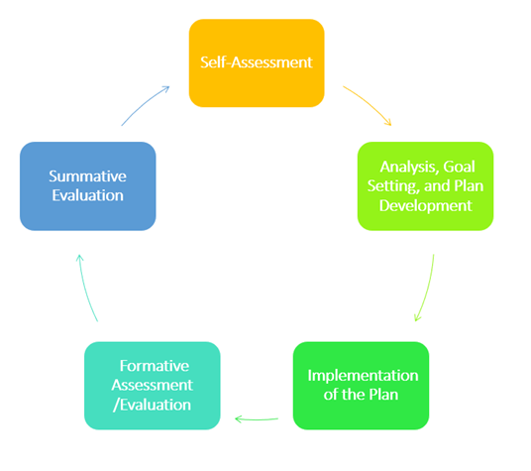
The 5-Step Cycle
The 5-Step Cycle is central to the educator evaluation framework. It positions educators as the drivers of their professional growth by prioritizing self-reflection and goal-setting.
Educators are encouraged to approach this process with an eye toward:
How can I engage in this process to cultivate meaningful feedback and support that strengthens my practice?
Notes:
Key points:
The 5-Step Cycle is central to the educator evaluation framework. It positions educators as the drivers of their professional growth by prioritizing self-reflection and goal-setting. Being cyclical reiterates that, like students, educators should have continuous opportunities to learn and grow as professionals.
Educators are encouraged to approach this process with an eye toward: how can I engage in this process to cultivate meaningful feedback and support that strengthens my practice?
The next set of slides provide specific recommendations for the Educator and Evaluator in implementing each step of the cycle in a way that supports culturally responsive practice and meaningful feedback.

Slide 11
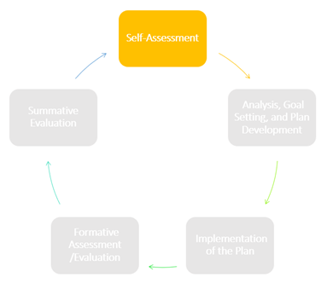
Self-Assessment
The educator reflects on performance and feedback to inform goal-setting and plans for professional learning over the cycle
Recommendations for EDUCATORS:
Recommendations for EVALUATORS:
Reflect on your experience in remote and hybrid settings - What skills or practices did you adopt that you want to reinforce? Where do you want to continue to grow?
Use student and family feedback, in addition to assessment data, to learn about your incoming students’ strengths and areas for support
Use the Self-Assessment Tool to identify Focus Indicators around which to target your goal-setting and professional learning
Initiate a dialogue with each educator about their hopes, needs, and aspirations for the school year
Promote coherence by communicating school and district goals, priorities, and initiatives
Provide opportunities for educator collaboration and professional learning in support of ongoing self-reflection and deeper understanding of students’ social-emotional and academic needs

Slide 12
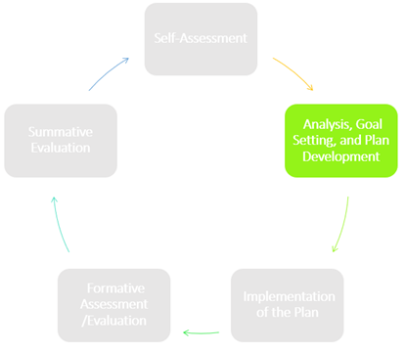
Goal-Setting & Plan Development
The educator and evaluator confirm goals and identify supporting activities, resources, and evidence
Recommendations for EDUCATORS:
Recommendations for EVALUATORS:
Identify S.M.A.R.T.I.E. Goals based on your self-assessment and analysis of student needs
Consider team goals to support collaboration and coherence
Prioritize goals that aim to disrupt inequity and promote a more equitable and inclusive learning experience for your students
Plan ways to demonstrate progress towards goals and the authentic evidence that illustrates that progress
Support educators to set meaningful goals aligned to their priority areas for professional growth and development
Use the Evidence Collection resource to identify and plan for the meaningful and supportive use of evidence throughout the evaluation cycle
Identify activities and opportunities for educators to develop their practice aligned with their goals

Slide 13
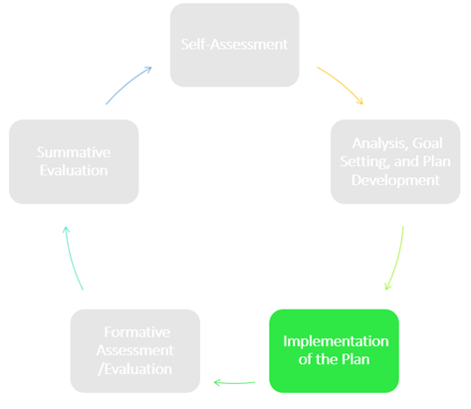
Plan Implementation
The educator pursues their professional practice and student learning goals and continuously reflects on progress, using regular feedback from the evaluator, students, and families
Recommendations for EDUCATORS:
Recommendations for EVALUATORS:
Engage in ongoing reflection and continuous learning towards your goals and in service of equitable outcomes for students
Routinely collect student and family feedback and use it to make adjustments
Leverage peer observations for additional feedback and support
Ask educators for input on areas of focus for observations and feedback
Seek opportunities to calibrate with other evaluators to build a shared understanding of effective, culturally responsive practice and high-quality feedback
Continuously reflect on your own biases and how they may be informing your feedback and judgments on practice

Slide 14
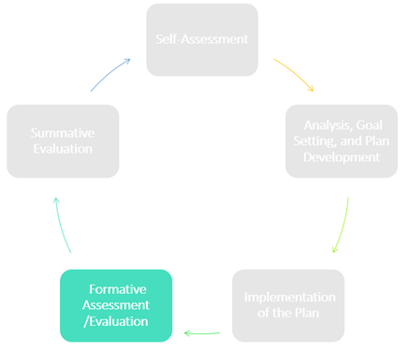
Formative Assessment/Evaluation
Mid-cycle opportunity to take stock of progress, provide feedback, and make adjustments as necessary
Recommendations for EDUCATORS:
Recommendations for EVALUATORS:
Share examples and artifacts of your practice that tell a story about your performance and progress towards your goals
Identify areas for ongoing support and feedback
Use multiple, holistic sources of evidence, including student and family feedback and educator reflections, to inform judgments and prioritize feedback
Ask educators what they would like to focus support and feedback on through the end of the cycle
Create space for educators to provide feedback on their experience with the evaluation process and make mid-course adjustments as needed

Slide 15
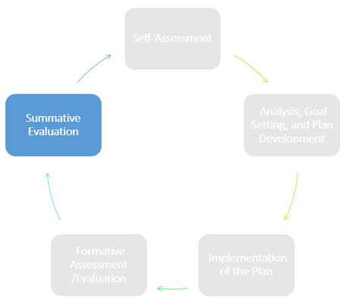
Summative Evaluation
End-of-cycle opportunity for reflection, analysis, and feedback
Recommendations for EDUCATORS:
Recommendations for EVALUATORS:
Reflect on progress towards goals and evidence of student learning
Consider new or innovative practices adopted this year to continue next year
Consider how this feedback will inform your goal(s) for next year
Reflect on the process and how it could be more culturally responsive going forward
Use multiple, holistic sources of evidence, including student and family feedback and educator reflections, to inform judgments and prioritize feedback
Underscore the importance of continuous learning in conversations about educator goals and performance
Recognize and celebrate educators demonstrating exemplary practice in specific areas or generally
Reflect on the process and how it could be more culturally responsive going forward

Slide 16
Resources
Educator Evaluation Implementation Resources
Tools and resources supporting meaningful, culturally responsive educator evaluation.
OPTIC Content Fellows’ Culturally Responsive Teaching Collection
Facilitators guide and resources for using OPTIC to build a shared understanding of culturally responsive teaching
Culturally Responsive Teaching Video Library
A set of video examples of culturally responsive practice by Massachusetts educators
MA Blueprint for English Learner Success
A set of guidance and resources for developing systems of support for English Learners at the classroom, school, district, and state levels.
Acceleration Roadmap: Pathway to an Equitable Recovery
A tool for teachers and leaders to support acceleration of student learning in the 2021-22 school year.

