Slide 1
Special Education Leaders Meeting
Friday, October 18, 2024

Slide 2
Our Educational Vision
From DESE's Educational Vision:
DESE works with districts, schools, and educators to promote teaching and learning that is antiracist, inclusive, multilingual, and multicultural; that values and affirms each and every student and their families; and that creates equitable opportunities and experiences for all students, particularly those who have been historically underserved.

Slide 3
Today’s Agenda
General Supervision Updates
Special Education Updates
New IEP Updates

Slide 4
General Supervision Updates

Slide 5
Components of General Supervision

Slide 6
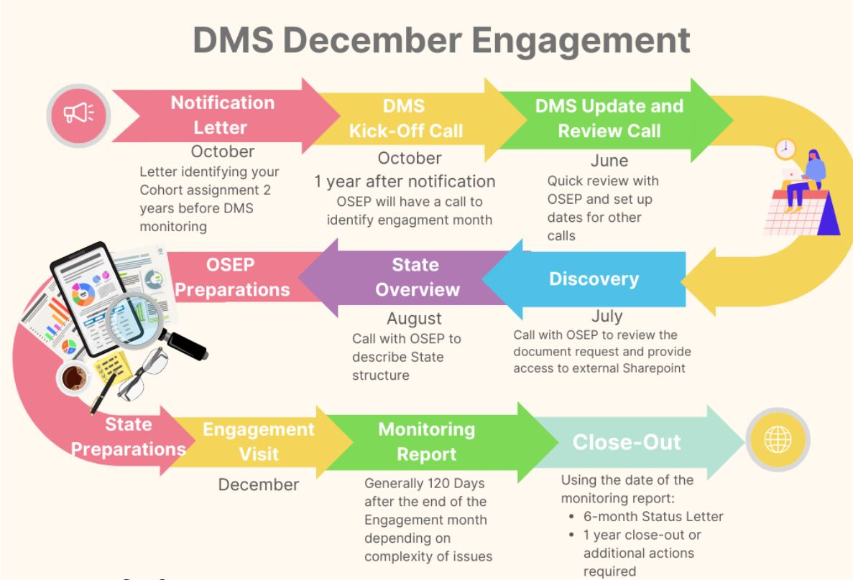
OSEP Differentiated Monitoring System Flowchart
Office of Special Education Programs (OSEP)
Differentiated Monitoring System
December 2025

Slide 7
Special Education Priorities 2024-2025
OASES Monitoring Procedures
PRS General Education Procedures
Champ Software Development Across Offices
Fiscal Monitoring Procedures
LEA Determinations and Aligned Technical Assistance
Policies and Procedures
Collection, Reporting, and Use of Data
Special Education Website

Slide 8
Special Education Updates

Slide 9
DESE Special Education Leadership
Iraida J. Alvarez, Acting Executive Director of Special Education
Jamie Camacho, Acting State Director of Special Education
Office of Approved Special Education Schools
Jannelle Roberts, Acting Director
Special Education Planning and Policy Development
Jamie Camacho, Director
Patrick Fitzgerald, Assistant Director
Theresa Senio, Assistant Director
Office of Public School Monitoring
Vani Rastogi-Kelly, Director
Amy Paulin, Assistant Director
Office of Problem Resolution System
Vacant, Director
Kelsey LoDuca-Towne, Assistant Director
Special Education in Institutional Settings
Shawn Connelly, Director

Slide 10
Website Survey Coming Soon!
The Special Education office will be sending out a survey to gain feedback on how schools and families use the special education content on the DESE website.
The survey will be anonymous and take approximately 7-10 minutes
The survey will be linked in the Special Education Bulletin and future Special Education Webinar slides
Districts will also be sent the survey link directly from DESE with communication for families (and the survey will offer translations for families as well)
Your feedback will help us identify what’s working well and where improvements can be made to better meet the needs of the special education community.

Slide 11
MAICEI: A fully inclusive college experience for students with intellectual disabilities, autism, or developmental disabilities
Can be considered for students with an intellectual or developmental disabilities or autism spectrum disorder who want to have a fully-inclusive college experience.
Can be incorporated into legally required transition services.
Students:
Are enrolled in college courses that support their career goals alongside their non-disabled peers, with necessary support, including any special education services for which they are eligible
Develop skills necessary for employment by participating in work-based trainings and internships
Gain self-advocacy skills
Learn skills necessary for independent living and independent travel
Participate in social activities on campus, including student organizations and other extracurricular activities of interest

Slide 12
Massachusetts Inclusive Postsecondary Education
MAIPSE
2024–2025 COLLEGE PARTNERSHIPS
Northern Essex Community College
P
Massachusetts College of Liberal Arts
P
Greenfield Community College
Fitchburg State University
University of Massachusetts Lowell Middlesex
Community
College Salem State University
MassBay Community College (Self-sustaining) Massachusetts College of Art & Design
University of Massachusetts Amherst
Holyoke Community College
(Self-sustaining)
Westfield State University
P
Quinsigamond Community College
Framingham
State University
Worcester State University
University of Massachusetts Boston
Roxbury Community College
P
Massasoit Community College
Community Colleges
Bridgewater State University
State Universities
University of Massachusetts
Bristol Community College
P
Planning year
Cape Cod Community College

Slide 13
Interagency Review Team (IRT)
The Interagency Review Team is a group of state agencies and school district(s), as applicable, that conduct reviews and issue determinations for complex cases for youth/young adults under 22 years of age who reside in the Commonwealth of Massachusetts.
We are in the process of finalizing the website.
Email for IRT: irt-complexcases@mass.gov

Slide 14
What is a Complex Case?
A Complex Case is a case involving an individual as defined in 101 CMR 27.03 ( 101 CMR 27.00: Interagency review of complex cases | Mass.gov),where there is a lack of consensus or resolution between state agencies as to the individual’s current service needs or placement, and the individual is waiting in a hospital emergency department, a medical bed, at home or other location and in urgent need of a disposition (placement or identifying entity responsible for payment).
A complex case will not include: Individuals who are deemed to meet hospital level of care requiring admission to an acute care hospital or inpatient psychiatric facility inclusive of the Department of Mental Health (DMH) Adolescent Continuing Care Unit (ACCU), an Intensive Residential Treatment Program (IRTP), or at a psychiatric inpatient developmentally disabled unit; or cases where there is agreement as to the services or placement necessary for the individual, including agreement as to which entity is responsible for payment, and the individual has been on the waiting list for such services or placement for less than 60 days.

Slide 15
1. Disproportionality Applied to Alternate Assessment Decisions (MCAS-Alt)

Slide 16
Background
The 2015 reauthorization of the Elementary and Secondary Education Act (ESSA) includes a 1.0% cap on state-level participation rates in the alternate assessment aligned to alternate academic achievement standards (MCAS-Alt in Massachusetts).
This assessment is for students with the most significant cognitive disabilities. Massachusetts was required (per ESSA) to establish guidelines to apply in determining, on a case-by-case basis, which “students with the most significant cognitive disabilities” will participate in the alternate assessment (MCAS-Alt).
DESE must apply for a waiver if we expect to exceed the 1.0% cap (34 CFR 200.6(c)(4)).
One component of a state’s waiver application requires that it address any disproportionality in the identification of students with the most significant cognitive disabilities that are assigned the MCAS-Alt.
Disproportionality exists in the MCAS-Alt participation when there are atypical differences in the proportions of participants from a student group who took the MCAS-Alt compared to those who took the general assessment.

Slide 17
Requirements for DESE
DESE must provide evidence that it has verified that each district that anticipates testing more than 1.0% of its assessed students in any subject using an alternate assessment:
(1) followed the state’s guidelines for participation in the MCAS-Alt; and
(2) will address any disproportionality in the percentage of students in any subgroup under section 1111(c)(2)(A), (B), or (D) of the Act taking an alternative assessment aligned with alternate academic achievement standards (34 CFR 200.6(d)), consistent with section 612(a)(16) (C) of the IDEA.
These student subgroups include:
White, Black or African American, Hispanic, Native American or Alaska Native, Asian, Pacific Islander, and Multiracial; and
Low-income students and English learners.

Slide 18
Additional Requirements for DESE
DESE must also provide a plan and timeline to address any disproportionality in the percentage of students taking the MCAS-Alt (34 CFR 200.6(c)(4)(iv)(C)).
The law does not explicitly define the term “disproportionality” or provide specific guidance on methodology for analysis of disproportionality for students taking alternate assessments.
DESE is therefore charged with developing the following guidance, methodology, and plan for districts.

Slide 19
Guidance and Methodology
First: DESE will provide guidance and methodology to help districts determine if disproportionality exists.
Second: DESE will provide districts with an outline to develop actionable steps and a reasonable timeline to implement revised processes to determine which students are designated for the MCAS-Alt.

Slide 20
2. How to Calculate Disproportionality for the MCAS-ALT

Slide 21
Disproportionality Defined
Disproportionality for the MCAS-Alt occurs when one of the student subgroups is designated at a significantly different rate than the proportion that participated in the general assessment.
Defined as an overrepresentation and under-representation of a particular population of demographic subgroup in the overall student population.

Slide 22
Disproportionality Guidance
Risk ratio* is a term often used to describe the relationship of observed versus expected proportions.
Calculated by dividing the proportion of MCAS-Alt participants in a particular subgroup by the proportion of students in the same subgroup who take the standard MCAS.
A risk ratio of 1.0 indicates that the proportion of students in a subgroup who are MCAS-Alt participants is the same as the proportion of students in that subgroup who take the standard MCAS. Therefore, there would be no evidence of disproportionality when the risk ratio is at or very near 1.
Significantly disproportionality occurs when the risk ratio is $≥3$ times the percent of students that participate in the MCAS-Alt compared to the general assessment.
*A risk ratio is one method to analyze for disproportionality. Districts may develop their own reasonable strategy (e.g., use percentages).

Slide 23
Risk Ratio Formula
Illustration of MCAS-Alt and Standard MCAS Test Proportions for a Subgroup
 | MCAS-Alt Participants | Standard MCAS test participants
Subgroup | 148 | 15,000
Non subgroup | 302 | 35,000
Total | 450 | 50,000
Subgroup Proportions (%) | 32.9% | 30.0%
Risk ratio: This is simply calculated by dividing the proportion of Subgroup MCAS-Alt participants by the proportion of subgroup students who are non-participants. Drawing from the previous example, the calculation is as follows:
$$\frac{Proportion of subgroup Participants}{Proportion of subgroup Non−Participants}= \frac{32.9}{30.0}=1.10$$
In the example above, a risk ratio of 1.10 does not represent significant disproportionality.

Slide 24
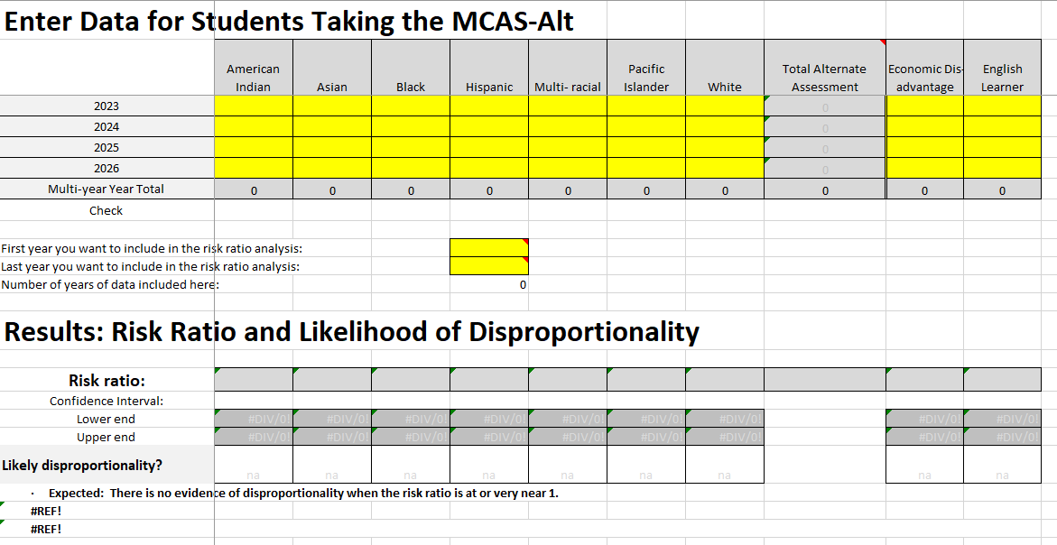
Worksheet to Calculate Risk Ratio
Districts can use the risk ratio template worksheet to help determine if disproportionality exists.
District staff members will enter their MCAS-Alt and MCAS participation data in the highlighted yellow cells.
Sample Formula Worksheet to Calculate Disproportionality Risk Ratio

Slide 25
3. Evaluating Disproportionality Data for MCAS-ALT and Developing a Local Action Plan

Slide 26
Questions to Guide MCAS-Alt Disproportionality Discussion
Is the number of students in the identified group large enough to have a valid result?
For example, in very small districts, the number of students in some subgroups may be so small that even one or two students in a subgroup may have a substantial effect on the results.
Is there a plausible reason to have the disproportionality?
For example, if the number of students in a subgroup in the district is small but there is one family in the district in that subgroup that has three students taking the MCAS-Alt, there may appear to be disproportionality, but it could be justified.
Is the disproportionality significant and is there a need to address it?
For example, if the risk ratio is 1.5%, it may not be significant, but a risk ratio of 3.0% may warrant further investigation.

Slide 27
Causes and Action Plan
What root cause may be contributing to this disproportionality?
Identify factors contributing to significant disproportionality, such as:
Are IEP Teams considering using special access accommodations for students before assigning the MCAS-Alt?
Do students in your school qualify to participate in the alternate assessment based on the new eligibility criteria?
Are IEP Teams considering how economic, cultural, or linguistic barriers may affect their process?

Slide 28
Recommended Timeline
Conduct a review of Policies, Practices, and Procedures (PPP)
Based on responses to the root cause questions, how can staff review the PPPs?
What timeline makes sense for the school?
Two school years to achieve a desired goal to reduce disproportionality overtime.
Year 1 – revise procedures and policies and train staff
Year 2 – continue to implement procedures and evaluate if disproportionality has reduced
Continue to train staff and revise procedures, if necessary.

Slide 29
Updates on IDEA Data
Significant Disproportionality
Indicator 7
Fall 2024 Child Count

Slide 30
DESE must calculate disproportionality with respect to:
Identification | The identification of children ages 3 through 21, as children with : A disability An intellectual disability A specific learning disability Emotional disturbance Speech or language impairments Other health impairments Autism
Placement | Placements of children with disabilities ages 6 through 21: Inside a regular class less than 40% of the day Inside separate schools and residential facilities
Discipline | Discipline incidents, including, for children with disabilities ages 3 through 21: 10. Out-of-school suspensions and expulsions of 10 days or fewer 11. Out-of-school suspensions and expulsions of more than 10 days 12. In-school suspensions of 10 days or fewer 13. In-school suspensions of more than 10 days 14 . Disciplinary removals in total

Slide 31
SY2024-25 Identifications
Significant Disproportionality data will be published in Edwin in the coming weeks
Edwin Analytics -> Student Enrollment Indicators -> Special Education -> SP301 Significant Disproportionality in Special Education
A letter will go out to all Superintendent/Charter School Leaders notifying them of their status
DESE will follow up with Identified and At-Risk Schools/Districts regarding next steps:
Root Cause Analysis
Internal Policies, Practices, and Procedures Review
Action Plan Development and CCEIS Budgeting for FY26
DESE is working to secure a vendor to assist identified schools and districts with conducting root cause analysis and action plan development.

Slide 32
Early Childhood Outcomes: Indicator 7
Indicator 7 Data Measures Three Child Outcomes for children receiving early childhood special education services.
Positive social-emotional skills (including social relationships),
Acquisition and use of knowledge and skills (including early language/communication and early literacy), and
Use of appropriate behaviors to meet their needs.
New policy memo regarding Indicator 7 data collect can be found here

Slide 33
Indicator 7 Data Collection and Entry

Slide 34
Indicator 7 Reminder (NEW)
All districts are required to collect and submit Indicator 7 entry and exit data for all students receiving preschool special education. For the 2024-25 school year, collect entry data for all students who enter or exit preschool special education between 7.1.24 and 6.30.25.
The listing of students in the database is updated three times per year following the SIMS certification windows. The October SIMS data will be in the database by late November 2024.
To facilitate data management, we suggest using a secure internal spreadsheet with the same fields as those listed in the database.
To gain access to the database, please contact your directory administrator to assign the roles of Special Education State Performance Plan and Indicator 7 Drop Box User.
The “Exit Exception” should be used when students leave the district quickly and there is not a chance to collect exit data.
Contact Zach Weingarten (zweingarten@air.org) and Taletha Derrington (tderrington@air.org) with any questions.

Slide 35
IDEA Fiscal Updates
Resolution Funds and Equitable Services

Slide 36
Child Count - Parentally Placed Private and Home School Children
MA Education Security Portal Child Count open for SY24-25 on November 1, 2024
FC 240 (ages 3-21)
Number of eligible parentally placed private school students attending school in the district who reside in the district.
Number of eligible parentally placed private school students attending school in the district who reside outside the district.
Number of eligible students who reside in the district and homeschooled under a district-approved plan.
Questions and Answers on Serving Children with Disabilities Placed by Their Parents in Private Schools (PDF)

Slide 37
Child Count – Parentally Placed Private Preschool Students
FC 262 (ages 3 – 5, not entered Kindergarten)
Number of eligible both resident and nonresident students parentally placed in a private elementary preschool in the district
“Elementary school” is defined in 34 C.F.R. § 300.13 as a nonprofit institutional day or residential school, including a public elementary charter school that provides elementary education, as determined under State law.
In Massachusetts, an elementary school is a school that provides instruction for grades one through five, six, seven, or eight.
FC 262 Child Count is included in FC 240 Child Count

Slide 38
Parentally Placed Private and Home School Students
Number of parentally placed private and home school students ages 3-21 evaluated by the district in SY 23-24
Of those students evaluated, the number of parentally placed private and home school students ages 3-21 found eligible for services by the district in SY 23-24
Total number of eligible parentally placed private and home school students ages 3-21 who received equitable services from your district in SY 23-24

Slide 39
Resolution Funds & Equitable Services
If you are unable to expend any remaining FY24 Resolution and/or FY23 Proportionate Share funds, provide the following to IDEAFiscal@mass.gov to receive written permission to revert for general allowable Part B expenses obligated on or before September 30, 2024:
Proportionate Share FY23 Questionnaire. Available in FY25 IDEA Application.
Copies of all written affirmations and other evidence of meaningful consultation and participation by schools and families at least three times a year including a narrative description of all efforts to engage and results.
Detailed explanation and all supporting documentation supporting the rationale claimed in the Questionnaire for not expending the funds.
General ledger evidence of the accounting of your district's unexpended funds.
Copy of the district's child find procedures for parentally placed private school and home school students in the district.

Slide 40
Updates for NI and NA Districts
Technical Assistance and Support
Fall 2024 Convenings

Slide 41
LEAs with NI & NA Determination TA and Support
SPED Strategies will continue to provide Special Education Determination improvement planning and support this year.
LEA Determination Status Timeline
Webinar Recording will be posted soon!
One-pagers are available now Needs Assistance (NA) Needs Intervention (NI)
New Special Education Administrator? Or New to Your LEA?
Check your LEA’s Determination and access information and resources
Visit School and District Profiles to check that your name and current email address are listed in your district’s directory and if not, contact your LEA’s Directory Administrator.

Slide 42
Save the Convening Dates and Register ASAP!
Needs Intervention Districts | Needs Assistance Districts
East: Oct 8-9th and Jan 15th Central: Oct 15-16th and Jan 22nd North: Oct 22-23rd and Jan 29th | East: Oct 10th and Jan 16th Central: Oct 17th and Jan 23rd North: Oct 24th and Jan 30th
If you haven’t received an email with registration information, please contact specialeducation@doe.mass.edu.

Slide 43
Early Childhood (EC) Transition Collaborative Convenings
AnLar is hosting four statewide EC Transition Collaborative Convenings throughout the 2024-2025 school year. These convenings will feature a panel discussion highlighting strategies that LEAs and EIS providers are using to support smooth transitions from Part C early intervention to Part B early childhood special education services. They will also include opportunities for you to connect with your colleagues and partner agencies to discuss specific topics related to early childhood transition. Each meeting will feature a different topic, outlined below. We encourage you to register for each meeting and invite your catchment area partners in early childhood transition!
Register here for January 15, 2025, 11:00 - 12:30 PM: Streamlining the Referral Process
Register here for March 13, 2025, 2:00 - 3:30 PM: Transition Conference
Register here for May 14, 2025, 10:30 - 12:00 PM: Streamlining Data Collection

Slide 44
New IEP Updates

Slide 45
IEP Improvement Process Timeline
Winter 2023
Spring 2023
SY 23-24
Fall 2023
Fall 2024
Finalize Forms and Tech Specs
Initial Training for Schools and Districts
Continued Training and Technical Assistance
Initial Adoption (at discretion of schools and districts)
Full Adoption Statewide
Thanksgiving

Slide 46
Meeting with IEP Vendors
Several vendors have been involved with districts throughout the state.
DESE has received questions regarding the requirements for IEP platforms.
DESE will meet with vendors to review requirements and discuss the status of the IEP platforms on November 8, 2024.
Invitations have been sent to vendors.
Contact us at specialeducation@mass.gov.

Slide 47
Information for Special Education Leaders
Regular Updates and Information
Special Education Bulletin
Special Education Website (Announcements)
Update Information in the Directory Administration
Special Education Leaders Meeting Invites and Memos
Email Contacts
specialeducation@mass.gov (General Special Education Inquiries)
IDEAFiscal@mass.gov (IDEA Fiscal Inquiries)
IDEAData@mass.gov (IDEA Data Inquiries- Special Education or SPP/APR Data)

Slide 48
Special Education Leaders Meetings 2024-2025
November 15, 2024 11:00-12:00
December 13, 2024 11:00-12:00
January 17, 2025 11:00-12:00
February 14, 2025 11:00-12:00
March 14, 2025 11:00-12:00
April 18, 2025 11:00-12:00
May 16, 2025 11:00-12:00
June 13, 2025 11:00-12:00

Slide 49
Q&A

