Slide 1
Special Education Leaders Meeting
June 2024

Slide 2
Our Educational Vision
From DESE's Educational Vision:
DESE works with districts, schools, and educators to promote teaching and learning that is antiracist, inclusive, multilingual, and multicultural; that values and affirms each and every student and their families; and that creates equitable opportunities and experiences for all students, particularly those who have been historically underserved.

Slide 3
Today’s Agenda
General Supervision Updates
Special Education Updates
New IEP Update

Slide 4
Special Education Leadership
Iraida J. Alvarez, Acting Executive Director of Special Education
Jamie Camacho, Acting State Director of Special Education
Office of Approved Special Education Schools
Jannelle Roberts, Acting Director
Special Education Planning and Policy Development
Jamie Camacho, Director
Patrick Fitzgerald, Assistant Director
Theresa Senio, Assistant Director
Office of Public School Monitoring
Vani Rastogi-Kelly, Director
Amy Paulin, Assistant Director
Office of Problem Resolution System
Barry Barnett, Director
Kelsey LoDuca-Towne, Assistant Director
Special Education in Institutional Settings
Shawn Connelly, Director

Slide 5
Special Education Updates

Slide 6
FY24 IDEA Equitable Services Resolution Funds' Year 3 Allocation Self-Assessment
The Department will be monitoring the expenditure and use of IDEA Resolution Funds. A district’s failure to use the FY2024 Resolution Funds by September 30, 2024 may result in enhanced monitoring and oversight from the Department. The Resolution Funds must be tracked separately and apart from other IDEA Part B funds. Please submit the required end-of-year self-assessment by completing this form before Friday, June 28, 2024. This form requires you to report the actual spending for the Resolution Funds as of the date this self-assessment is completed and submitted. After reviewing the self-assessment, the Department may request more information, and some districts may be selected for enhanced monitoring. For additional information about the Resolution Funds, please email IDEAFiscal@mass.gov

Slide 7
NI & NA Districts: Save the Dates!
SPED Strategies will be hosting special education determination improvement planning support during the 24-25 school year.
Additional information will be emailed directly to district leaders.
Needs Intervention Districts | Needs Assistance Districts
Southeast: Oct 8-9 and Jan 15 Central: Oct 15-16 and Jan 22 North: Oct 22-23 and Jan 29 | Southeast: Oct 10th and Jan 16th Central: Oct 17th and Jan 23rd North: Oct 24th and Jan 30th

Slide 8
2024-2025 Superintendents Checklist
Recommended Start by | Task
Ongoing | Mail Parent’s Notice of Procedural Safeguards to all households with students found eligible for special education services once during each school year. Provide copy of notice during other times required by 34 C.F.R. § 300.504(a).
June 2024 | Submit Conditions of Assistance with the IDEA consolidated grant application via GEM$ and update special education policies and procedures as required.
Fall | Review significant disproportionality determination(s) and develop or update action plans and review and update policies, procedures, and practices, as needed. Submit action plans and required documentation to the Department. Plan for 15% set aside for LEAs identified as having significant disproportionality during next fiscal year.
Determinations Issued in March | Review LEA Determinations for Special Education and develop or update action plans. Plan for 2% set aside for improvement planning for LEAs identified as "Needs Improvement" for the next fiscal year.
Ongoing | Collect district level information related to the use of C/CEIS funds as well as the total number of children serviced and total number found eligible for special education and/or related services who were serviced under those funds. Submit information to the Department in Late Spring 2025.
10/1/2024 | Submit child count for parentally placed and homeschooled children in private schools.
Spring | Conduct Indicator 14: Post School Outcomes data collection activities for exiters from previous school year.
Ongoing | Enter entry and exit ratings for Indicator 7: Preschool Outcomes in the ECOS application in the Security Portal. ECOS is updated three times a year after SIMS submissions.

Slide 9
2024 Summer Checklist
Plan for PRS Responses and Record Requests, as needed
IDEA Part B Fund Codes 240 and 262
Tentative Special Education Leaders' Meetings Dates
MCDHH Educational Interpreter Registration
Data Collection
Indicator 14 (Post School Outcomes) Surveys
Indicator 7 (Preschool Outcomes)
Communication
Directory Administration
DESE Newsletters, Updates, and Livestreams: https://www.doe.mass.edu/news/newsletter-signup.html

Slide 10
IDEA Part B Fund Codes 240 and 262
Conditions of Assistance: IDEA Part B Funding Certifications
“General Education Program Act” (GEPA) Statement.
FY23 MOE Compliance
Comprehensive Coordinated Early Intervention Services (CCEIS)
Making Money Matter (M³)
Equitable Services
In the event an LEA asks to change the IDEA child counts after they are certified, the Department will ask for a written explanation of the changes, the written affirmation(s), and district IDEA Child Count Policies and Procedures.
LEAs that have unexpended FY24 Resolution Funds will be required to provide information to the Department that may include a plan for expending funds and/or other documentation such as written affirmations.

Slide 11
General Supervision Update

Slide 12
Components of General Supervision

Slide 13
2023-24 DESE/BSEA General Supervision Related Updates and Initiatives
OASES Procedures
PRS Procedures
PSM Procedures
Dispute Resolution and Mediation Procedures
Fiscal Monitoring Procedures
LEA Determinations
Policies and Procedures Manual
Conditions for Assistance
Data Protocols
Technical Assistance

Slide 14
Preview for 2024-2025
Follow-Up from 2023-2024
OASES Procedures
BSEA Dispute Resolution and Mediation Procedures
LEA Determinations
Technical Assistance
New for 2024-2025
Fiscal Monitoring Procedures
Data Protocols
Policies and Procedures Manual

Slide 15
New IEP Update

Slide 16
New IEP Resources
Supporting English Learners with Disabilities with the New Individualized Education Program (IEP): Quick Reference Guide
Information for Parents with The New Individualized Education Program (IEP) Form: Quick Reference Guide
Transition Planning with the New Individualized Education Program (IEP) Form: Quick Reference Guide
Discussion Questions to Get Ready for My Yearly IEP Meeting (Student Questionnaire)
Sample High School IEP

Slide 17
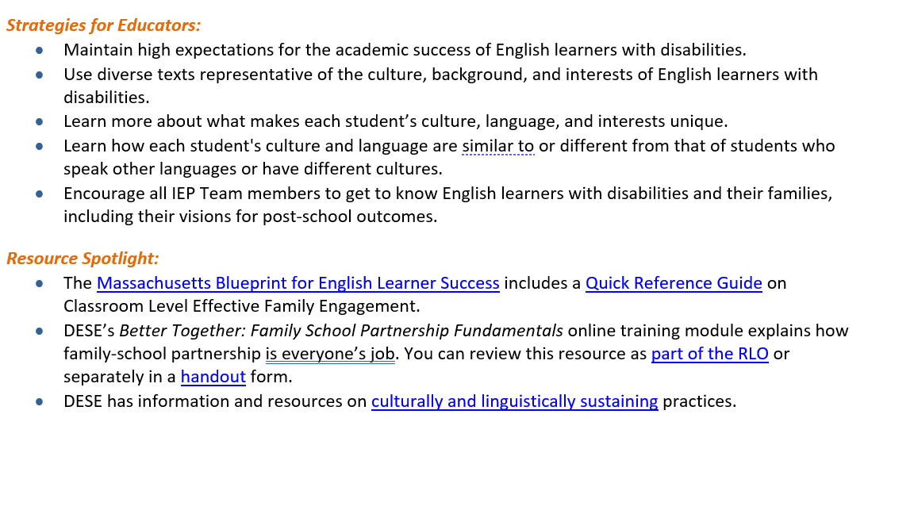
Supporting English Learners with Disabilities with the New Individualized Education Program (IEP): Quick Reference Guide
Discusses how each of the five focus areas and accompanying strategies and resources can improve the support and outcomes for English Learners with disabilities.
Example: Focus Area 1: Family and Student Voice

Slide 18
: What Parents Need to Know About the New Individualized Education Program (IEP): Quick Reference Guide
This Quick Reference Guide shares ways to:
Prepare for IEP meetings,
Collaborate with school professionals to use the new form during IEP meetings, and
Partner with school professionals throughout the year to put the IEP into action.
It provides helpful tips for Before, During, and After the meeting with helpful resources for:
1. Student Participation
2. The new IEP Data:
The Student Profile
The four “Present Levels of Academic Achievement and Functional Performance”
The Accommodations and Modifications
3. Secondary Transition
4. Participation in general education and the life of the school

Slide 19
Transition Planning with the New Individualized Education Program (IEP) Form: Quick Reference Guide
5 Strategies - one for each focus area:
Strategy 1: Start with the end in mind by clearly defining what the student wants for the future.
Strategy 2: Regularly gather data using transition assessments to promote effective planning.
Strategy 3: Transition planning is an ongoing process, not something that occurs only during the annual IEP meeting.
Strategy 4: Present levels and goals sections focus on academic and functional skills necessary for postsecondary success.
Strategy 5: Collaborate with community-based partners to develop a coordinated transition plan that allows the student to build skills and explore post-school opportunities within and outside school.
Each Strategy is accompanied by recommended resources
For more information and planning considerations related to completing the secondary transition planning section of the new IEP form, see pages 10-13 of the MA IEP Technical Guide.

Slide 20
Discussion Questions to Get Ready for My Yearly IEP Meeting (Student Questionnaire)
Questions for:
Self-Determination: Strengths, Challenges, and Helpful Strategies
Student Vision/Postsecondary Goals: Postsecondary Education/Training, Employment, Independent Living, including Community Participation
Planning For My Role in My IEP Meeting
Recommended use at least annually as one tool to prepare for the IEP meeting.
Work with students to determine which question is appropriate.
Not every question needs to be answered.
Support students in responding in their own words.
Students are given options on how they would like to participate in the meeting (examples: write an outline, read a statement, make a PowerPoint, lead your IEP meeting, etc.).
The students are asked if they would like any help preparing for the meeting or what would be helpful to prepare them for the meeting.

Slide 21
Sample High School IEP
Illustrative examples of what the new IEP might look like in practice
Purpose of these samples is to help educators, parents, and other stakeholders envision what the new IEP may look like when completed
Samples are not exemplars
DESE offers them for your reference only; they are not intended to represent the best or only approach to IEP development, supports, and services
Each IEP must be developed based on the needs of the individual student and in accordance with all applicable federal and state requirements
Purple annotations- help you reflect on certain sections of the IEP form and to offer suggestions for potential ways to use the relevant sections
Annotations in purple are provided for informational purposes only and are not intended to limit the type of information that may be included under various sections of the form

Slide 22
Professional Learning Support 2024-2025 School Year
Purpose: To promote the successful implementation of the new IEP form.
Areas of need identified through the February survey:
New IEP Overview
Supporting EL
Information for Parents
Transition Planning
Goal Writing
Accommodation and Modification, and
Present Levels
Regional support
Remote, in-person, and blended learning formats

Slide 23
12 Updated IEP Forms
Attendance Sheet
Educational Environment and Placement (Ages 3-5)
Educational Environment and Placement (K-age 21)
Evaluation Consent Form
Extended Evaluation Form
IEP Amendment
Level of Need
Notice of Proposed School District Action
Notice of School District Refusal
Placement Consent Form (Ages 3-5)
Placement Consent (K-Age 21)
Special Education Eligibility Determination

Slide 24
Q&A

