Slide 1
DESE's Educational Vision and Strategic Objectives BESE Update June 18, 2024

Slide 2
DESE’ Educational Vision
DESE's Educational Vision
What outcomes do we envision as a result of our work?
Our vision is that as a result of their public education in Massachusetts, students will attain academic knowledge and skills, understand and value self and others, and engage with the world.
This will enable students to be curious and creative, shape their path, feel connected, and be empowered.

Slide 3
3 goals
Cultivate Systems to Support the Whole Student
Promote Deeper Learning
Expand and Sustain a Diverse and Effective Workforce
Physical and mental health and wellness
Safe and supportive school environments
Multi-tiered systems of support
Authentic partnerships with students and families
High quality and engaging instructional materials
Academic supports and interventions
High quality career and college pathways and programs
Holistic range of programming
Robust pipeline of well-prepared educators
Retention of diverse and effective staff
Opportunities for all staff to engage in a cycle of continuous improvement

Slide 4
DESE’s Core Functions
DESE's Core Functions
Setting expectations
Promoting and measuring quality and compliance
Supporting implementation and catalyzing innovation
Communicating and partnering with stakeholders

Slide 5
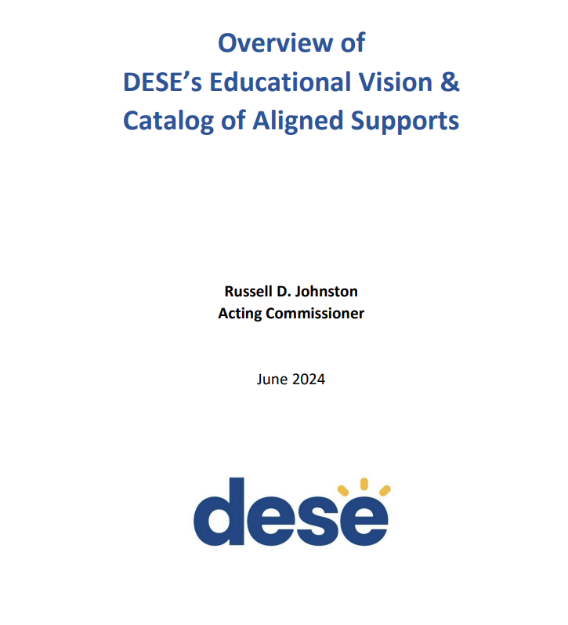
Since our May BESE meeting
DESE published the second annual Catalog of Aligned Supports to districts and schools.

Slide 6
Next steps
Implementing systems for progress monitoring
Planning for professional learning opportunities
Identifying the timeline and expectations for next year's planning process

Slide 7
Focus on holistic supports for newly arrived students
Supports for newly arrived homeless students and the districts welcoming them
SO1: Whole Student Supports
SO2: Deeper Learning
SO3: Diverse and Effective Workforce

