Slide 1
Accountability and Assistance Advisory Council Meeting
April 10, 2024
Notes:
Erica

Slide 2
Agenda
Welcome, meeting norms, and introductions
Discussion: Updates to the District Standards and Indicators
Next steps and closing
Notes:
Erica

Slide 3
Meeting Norms and Introductions
Notes:
Erica

Slide 4
Discussion Norms and Meeting Protocols
Promote risk-taking by not assigning specific comments to individual members in meeting summaries & minutes.
Maintain respect before, during, & after meetings.
Seek clarification & check understanding to avoid mistakenly attributing ideas to an individual or organization represented on the council.
Keep improvements in student learning at the core of the discussions. Students should drive the conversation.
Stay engaged in the issues.
Actively address implicit biases & instill cultural proficiency in discussions.
Encourage discussion from all voices of members. Be additive, not repetitive.
Let members know if pre-reading or other pre-meeting assignments require more than 30 minutes of preparation time.
Make it fun!
Notes:
Erica

Slide 5
Introductions
Council Co-Chairs Heidi Driscoll & Tim Piwowar
Council members
DESE staff
Please share:
  Your name
  Role or affiliation
  The meeting norm you hope to lean into today
Notes:
Erica

Slide 6
Updates to the District Standards and Indicators
Notes:
Erica

Slide 7
Background Information
Established by state statute (M.G.L. Ch.15 § 55A, Ch.16 § 1K) and regulations (603 CMR 2.03(6)(a) and (b))
The Office of District Reviews and Monitoring (ODRM) reviews approximately 20 districts each year
Since 2021, reviews have been conducted via a partnership between DESE and the American Institutes for Research (AIR)
  The review process includes document reviews, onsite visits, focus groups, classroom observations, data triangulation, and report writing/finalization
The purpose of a district review is to provide the state, district leaders, and the public with an in-depth look into the systems, structures, and practices of a school district and the ways they affect student experiences and outcomes.
Notes:
Robbie

Slide 8
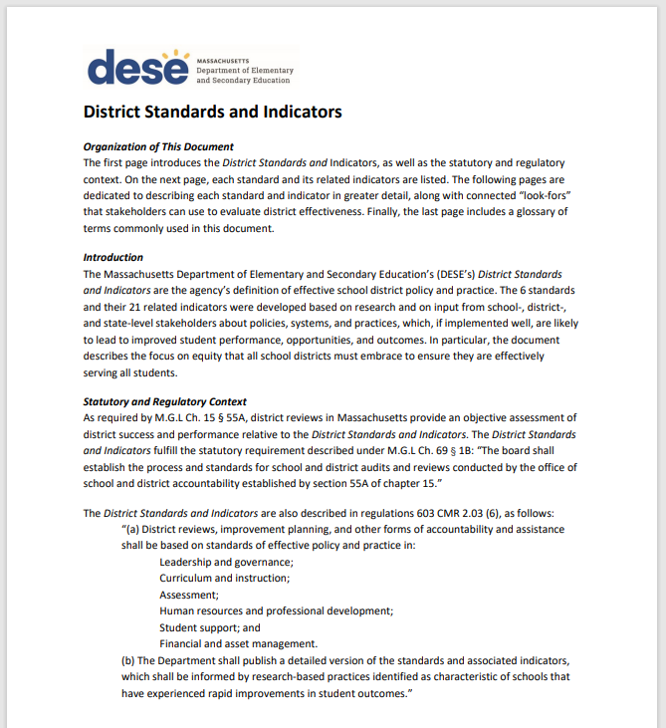
Current District Standards and Indicators
Document outlining the 6 standards (defined in regulation), 21 indicators, and numerous “look-fors”
DESE’s evidence-based definition of strong district systems, policy, and practice
Foundation of district review reports
  Inform the documents collected, questions asked, report findings, and recommendations issued
Last updated in 2018
We are in the process of updating the indicators and look-fors for the SY2024-25 reviews and beyond
Notes:
Robbie

Slide 9
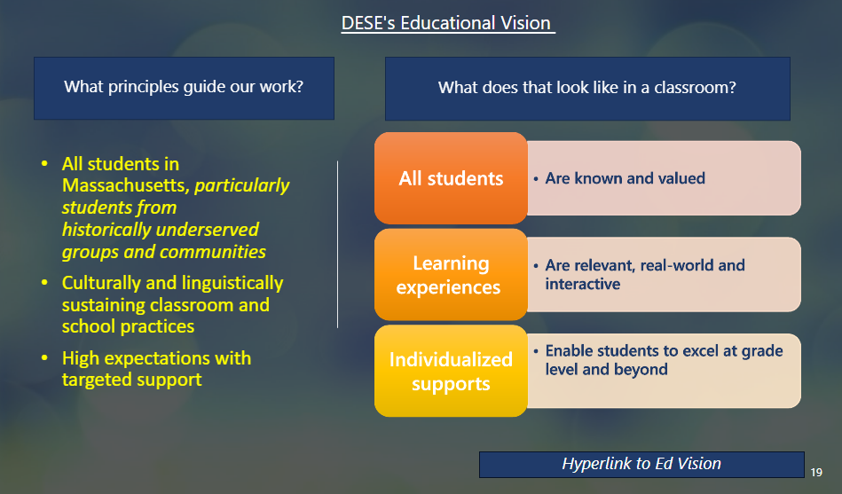
The Commissioner has charged DESE with a what and a how…
DESE's WHAT and HOW
What: Educational Vision
How: REDT & Coherent Planning
Communicated via: DESE Catalog (annually)
Notes:
Robbie

Slide 10
Project Objectives
Using DESE’s Racial Equity Decision-Making Tool (REDT) as our guide, the Office of District Reviews and Monitoring sought out to update the indicators and look-fors within the existing standards to…
Reflect the most recent and highest-quality research around best practices in education
Take an explicit equity lens
Communicate a cohesive vision for effective district systems that is aligned to DESE’s Educational Vision and can inform work throughout the Department
Notes:
Corinne
Ensure that district review reports highlight the ways in which district systems uphold and/or dismantle historic inequities
Ensure that district review reports uplift student, educator, and community voices and accurately capture their experiences

Slide 11
Project Timeline
Summer 2023
Fall/Winter 2023/24
Spring 2024 & Beyond
REDT Step 1: Define the Initiative
REDT Step 2: Analyze Data and Historical Context
REDT Step 4: Identify Racial Equity Strategies and Impact
REDT Step 5: Assess Implementation and Viability
REDT Step 6: Ensure Accountability
REDT Step 3: Engage Stakeholders
Notes:
Corinne

Slide 12
Our Process
Progress Thus Far
Reviewed similar practices in other states/localities
Conducted a content analysis of all reports issued in 2022-23
Gathered feedback from district leaders who recently underwent reviews
Convened 6 standard-specific committees of DESE staff
Developed a draft of the updated District Standards and Indicators based on feedback from internal stakeholders
Gather feedback from Board Advisory Councils and external stakeholders
Committees consisted of 35 content-area experts across the Department
Notes:
Corinne, with Charmie speaking to committee experience

Slide 13
Next Steps in the Process
Incorporating additional changes and edits to produce a final version
Implementing the updated District Standards and Indicators in district reviews taking place in the 2024-25 school year
Disseminating the District Standards and Indicators to support work across the Department, as well as in districts and schools
Notes:
Corinne

Slide 14
District Reviews and Assistance
Key Goals
Communicate a clear throughline to Educational Vision
Center the student experience + improved student outcomes
Center racial equity
Reduce burden on district while increasing impact on students
Notes:
Charmie

Slide 15
Key Learnings and Changes
Previous Version
Revised Draft
Lack of indicators and look-fors evaluating equity (particularly racial equity) work
Inconsistencies in the level of detail in each standard and indicator
Disconnect between indicators and look-fors and their effects on students
Outdated language that did not align with the Educational Vision and core DESE guidance
Missing pieces (ex: mental health systems, district operations, instructional leadership, etc.)
Emphasizes ALL students, including and especially those who have been historically underserved
Increased level of detail throughout for additional clarity
Intentionally centers students
Updated language that aligns with the Educational Vision, Coherence Guidebook, and DESE guidance
Added new indicators and look-fors
(21 → 24 indicators, 19 → 36 pages)
Notes:
Robbie
1) Our team conducted an analysis, found racial equity only really referenced in HRPD and SS.
2) C&I relatively detailed, but financial and asset management is greater
3) Language that makes clearer connection to impact students. New document does a better job of drawing the connection to why the systems matter. Heard over-and-over in committees.
4) Historically underserved, priorities in the EdVision
5) Missing pieces

Slide 16
Discussion
What stands out as a strong, positive change?
What is missing? What do you propose we add?
What groups might experience undue burden by these changes?
Are there any unintended consequences of these revisions?
To what extent do you think this draft demonstrates our objectives to:
  Reflect recent, high-quality research around best practices in education.
  Include a specific equity lens.
  Provide a cohesive vision for effective district systems that is aligned with DESE’s Educational Vision.
How could the indicators and look-fors be further revised to better accomplish these goals?

Slide 17
Feedback Form
We welcome additional feedback. Feel free to share this work with your networks through our online form, which will be open through April 30th.
Revised District Standards and Indicators draft: https://www.doe.mass.edu/accountability/district-review/documentation.html
Feedback form:
https://survey.alchemer.com/s3/7777801/Feedback-on-Updates-to-the-District-Standards-and-Indicators
Notes:
Whoever does prior slide finishes this out

Slide 18
Next Steps and Closing
Notes:
Erica

Slide 19
Upcoming Council Meetings
Next meeting
  June 12, 9:30am – 11:00am (Virtual meeting)
Building meeting agendas
  DESE staff will follow-up with a survey tool through which Council members can propose potential topics for upcoming meetings
Notes:
Erica

