Slide 1
How to Prepare & Distribute School & District Report Cards

Slide 2
Background Information
Report cards are important tools for sharing district & school information with families & the public
The federal Every Student Succeeds Act (ESSA) requires districts to annually distribute district & school report cards to the parents/guardians of all children enrolled in district schools
Report cards must include information related to assessment, accountability, educator qualifications, & other measures of school quality
Since 2007, the Massachusetts Department of Elementary & Secondary Education (DESE) has prepared district & school report cards & made them available via DESE’s School & District Profiles website

Slide 3
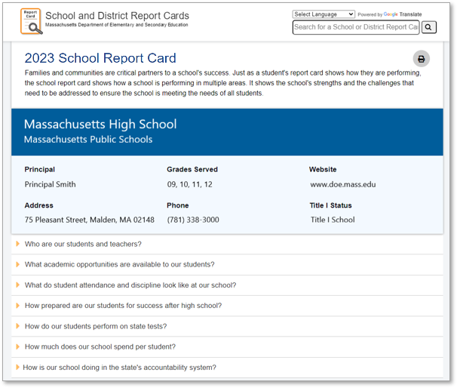
Report Card Design
The Department redesigned school & district report cards in 2018
Information included in the report cards reflects the values & priorities of Massachusetts parents
The Department surveyed parents & other stakeholders to collect information about what should be included in report cards
The Department used surveys, focus groups, & interviews to solicit feedback on a draft report card

Slide 4
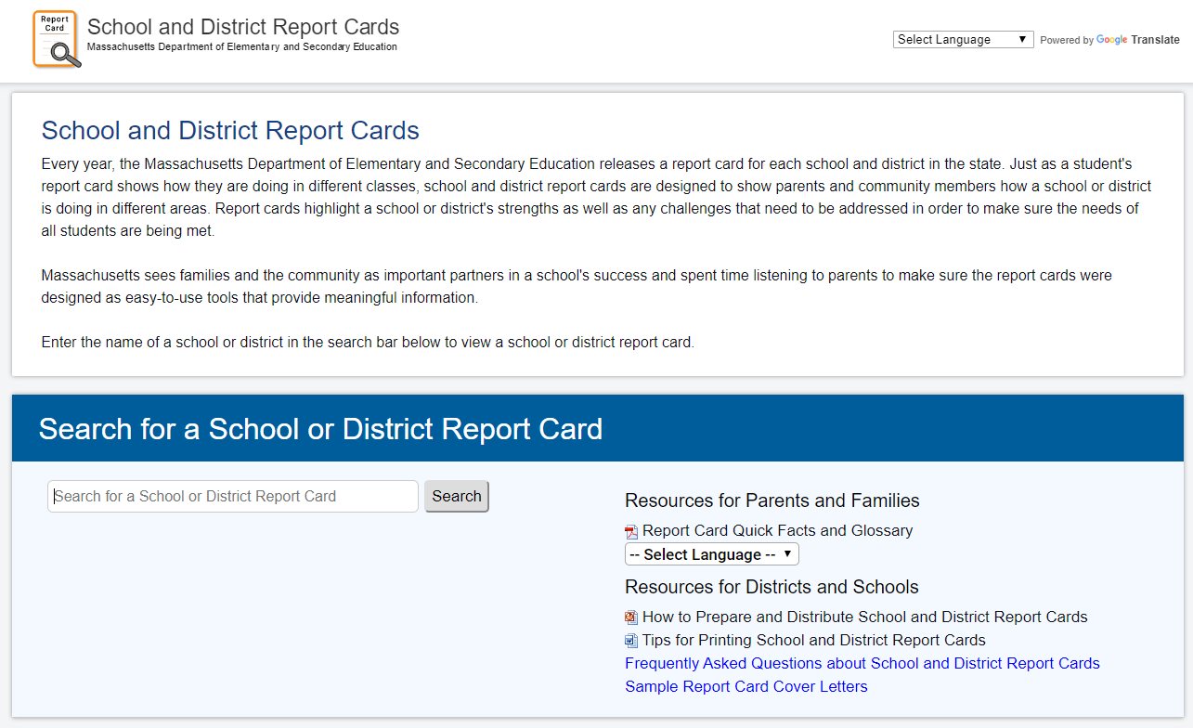
Accessing Report Cards – Option 1
Search for a school or district report card on DESE’s report card website:
reportcards.doe.mass.edu

Slide 5
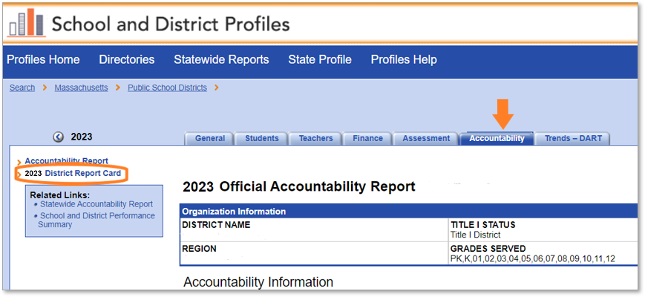
Accessing Report Cards – Option 2
Step 1: Find the school’s or district’s profile on DESE’s School & District Profiles website, & click the Accountability tab
Step 2: Click on the 2023 Report Card link that appears to the left of the accountability report

Slide 6
Distribution Requirements
District & school report cards must be posted on each district’s & school’s website
School report cards should be distributed to families of students enrolled in all district schools, regardless of the school’s accountability determination or Title I status
The Department recommends distributing report cards electronically
For families who prefer to receive a hard copy of the report card, a printable version of the report card is available. Instructions for printing report cards are available on DESE’s report card website
The Department has developed a sample parent/guardian notification that districts & schools may customize & use as a cover letter for the report card
Cover letters are available in English & nine other languages on DESE’s report card website

Slide 7
Timeline
The Department releases electronic report cards in late January
By the end of February, districts should:
Post links to report cards on school & district websites, &
Distribute electronic copies of school report cards to families. Hard copies of report cards should be distributed to families that require them

Slide 8
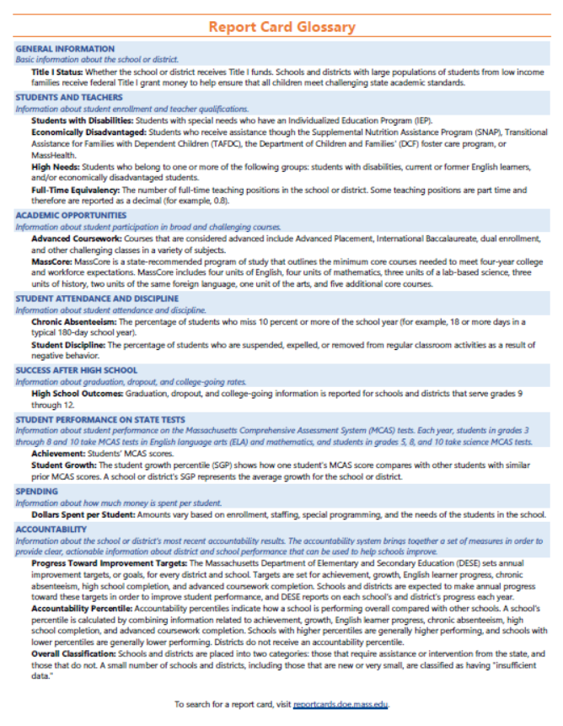
Supporting documents
Report card flyer describes the purpose of the school report card
Glossary defines key terms
Both documents are available in English & nine other languages

Slide 9
Questions?
Office of District & School Accountability Reporting
ElementarySecondaryEd.Act@mass.gov

